Slide 1
Samsung
Innovation
Campus
Coding and Programming

Slide 2
Chapter 3.
Effective Python Programing - Function, Closure, and Class
Coding and Programming

Slide 3
Chapter Description
Chapter objectives
Learners will be able to use functions and modular programming techniques. Learners will be able to use lambda expressions, which are expressions used to express simple functions. Learners will be able to understand the closure that receives the return value as a function after defining nested functions. In addition, learners will be able to define classes, which are important concepts of object-oriented languages.
Chapter contents
Unit 17. Function
Unit 18. Recursion Function Call
Unit 19. Lambda
Unit 20. Closure
Unit 21. Class

Slide 4
Unit 17.
Function

Slide 5
Unit learning objective (1/4)
UNIT 17
Learning objectives
Understand functions and be able to create user-defined functions.
Be able to name a function using the def statement and call the function using the function name.
Be able to use parameters to receive values from inside functions.
Understand and be able to use variable parameters, which are techniques for using convenient functions.
Be able to use default parameters when declaring functions. When calling a function using this default parameter, the default value is used when the parameter is not passed.
Be able to use parameters in any order by specifying keyword arguments when calling functions.
Be able to use the return statement to return the result of a function.

Slide 6
Unit learning objective (2/4)
UNIT 17
Lesson overview
Learn how to use built-in functions.
Understand the need for user-defined functions and learn how to define them.
Learn how to define and call a user-defined function using the def statement.
Learn how to use parameters to pass values to the called function.
Learn the types of type errors that occur when using parameters and how to deal with errors when they occur.
Learn how to efficiently pass values using variable parameters, default parameters, and keyword parameters.
Learn function return statements using return.

Slide 7
Unit learning objective (3/4)
UNIT 17
Concepts You Will Need to Know From Previous Units
How to use input and output functions.
How to use the main string methods such as join, split, and format methods, and use Python built-in functions such as sum and len.
How to use loop statements and use a break and continue to break or control loops.

Slide 8
Unit learning objective (4/4)
UNIT 17
Keywords
Function
Parameter
Type Error
Variable, Default, Keyword Parameter
Return

Slide 9
Unit 17.
Function
Mission

Slide 10

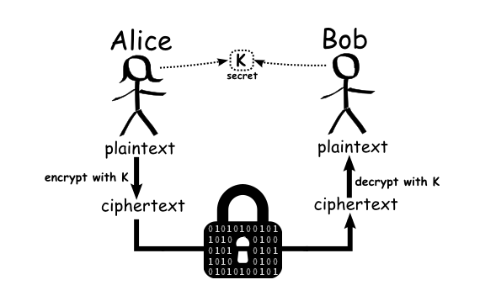
Mission
UNIT 17
1. Real world problem
1.1 Digital World and Encryption
Alice
Bob
In the digital world, it is very important to prove your identity and access information. At the same time, the problem of digital threats is becoming a serious problem, such as falsifying personal identities or accessing public information without legitimate authority.
When two people have private communications in a remote place, they should be able to send and receive information in an encrypted manner.
K
secret
plaintext
plaintext
encrypt with K
encrypt with K
ciphertext
ciphertext

Slide 11

Mission
UNIT 17
1. Real world problem
1.1 Digital World and Encryption
When people log in to the Internet, the website asks the user for an ID, password, etc. to prove themselves.
Most Internet sites and communication systems “encrypt” information when it is transmitted.
Let's encrypt my information through the historic Caesar cipher method among these methods of encryption. Let’s also learn how to define and call a function to solve this problem.

Slide 12
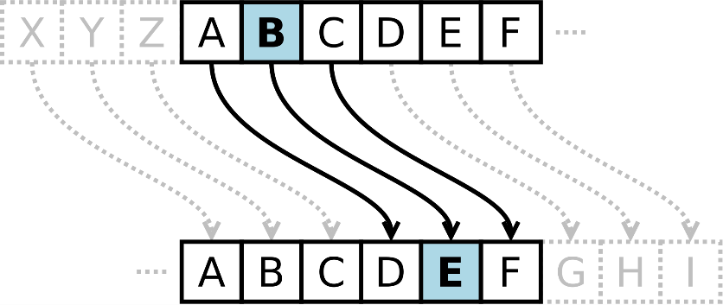
Mission
UNIT 17
1. Real world problem
1.2. Caesar Cipher
The Caesar cipher is a type of simple substitution cipher that is dealt with in cryptography.
In fact, Caesar, the Roman emperor, also used this Caesar cipher. The Caesar cipher is a method in which the content to be encrypted is replaced with another alphabet by pushing a certain distance for each alphabet.
For example, if 'COME TO ROME' is encrypted with the Caesar cipher that pushes out three letters, it becomes 'FRPH WR URPH’.
The Caesar cipher was created around 100 BC. It is a cipher created by the Roman general Caesar to communicate with his allies.
The Caesar cipher is simple, and it can be easily used by ordinary people. However, it has the disadvantage that it can be easily solved by using the frequency of spelling and frequently used words and forms.

Slide 13
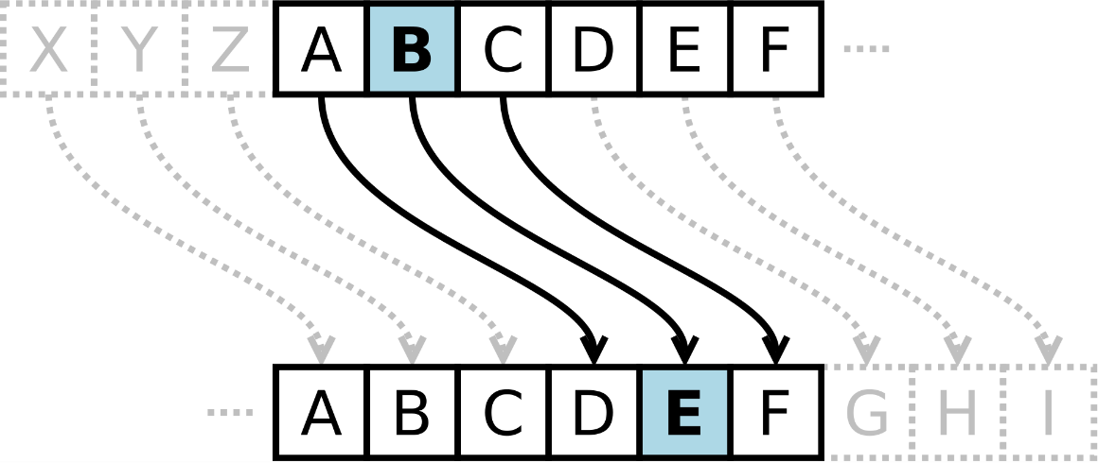
Mission
UNIT 17
1. Real world problem
1.2. Caesar Cipher
To learn more about the Caesar cipher, visit https://en.wikipedia.org/wiki/Caesar_cipher.
This encryption technique is known as one of the oldest encryption techniques.

Slide 14
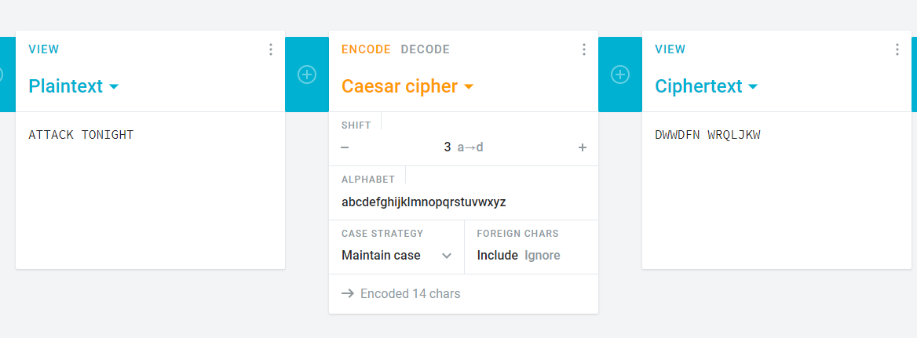
Mission
UNIT 17
1. Real world problem
1.3. Web Service for creating Caesar Cipher
Some web services provide a Caesar cipher encoder function.
When you visit the page, you can enter plain text to create ciphertext.
Enter plain text
Enter substitution rules
Return ciphertext
https://cryptii.com/pipes/caesar-cipher

Slide 15
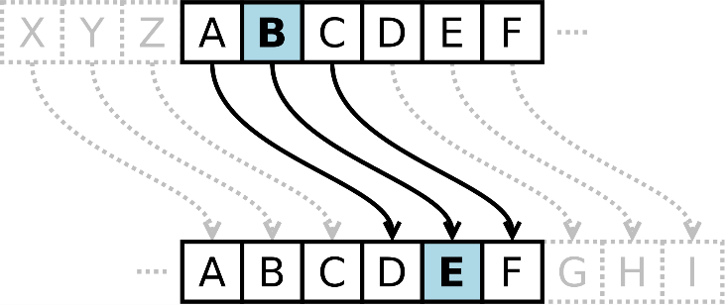
Mission
UNIT 17
2. Mission
2.1 Create a Caesar Cipher Program
Use Caesar encryption techniques to create a program to receive encrypted sentences as input and decrypt them. To solve the problem, import the string module and use ascii_uppercase. Let's solve the problem by putting this value in the following variables.
In this case, let's use string slicing.

Slide 16
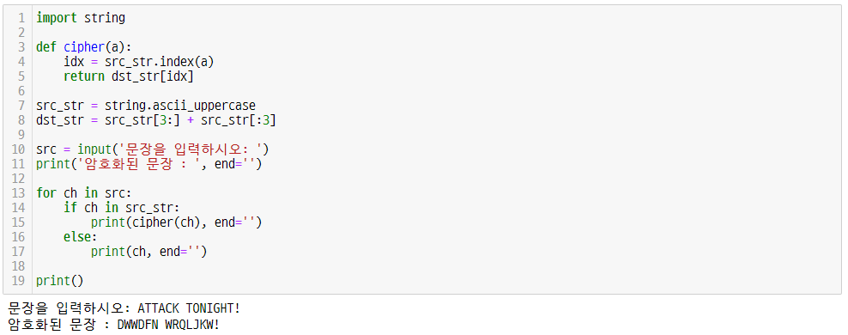
Mission
UNIT 17
2. Mission
2.2. How Caesar Cipher works
('Enter a sentence: ')
('Encrypted text : ', end='')
Enter a sentence: ATTACK TONIGHT!
Encrypted text : DWWDFN WRQLJKW!

Slide 17
Mission
UNIT 17
2. Mission
2.3. Programming plan
Pseudocode
Flowchart
[1] Start
[2] Enter a sentence
[3] Repeat for the number of characters in the string do{
[4] if the entered character is uppercase alphabet, then{
[5] Get the third next order of characters in the alphabet you entered
[6] print the character of ch }
[7] else{ print the character as it is entered}
[8] End
Start
src = input('Enter a sentence: ')
for ch in src
NO
YES
if ch in string.ascii_uppercase:
NO
YES
cipher(ch) using a function
print(cipher(ch), end='')
print(ch, end='')
End

Slide 18
Mission
UNIT 17
2. Mission
2.4. Caesar Cipher Program: final code
('Enter a sentence: ')
('Encrypted text : ', end='')

Slide 19
Unit 17.
Function
Key concept

Slide 20


Key concept
UNIT 17
1. Basic Structure of Function
1.1. Function is the basic building blocks of a program
In this unit, we are going to learn functions that play a very important role in programming.
A function is a set of codes that performs a specific operation within a program. It has the characteristic of being executed when it is called.
A function is the basic building block of a program.
The software we use is made by combining various functions and modules.
Think about assembling Lego blocks to create the shape you want. It is the same for making programs. To make a large program with more than tens of thousands of code lines, the necessary functions must be well combined and arranged in order.
Just like making a car shape with small pieces of blocks, we can make programs by combining functions!
Functions, Modules, and Classes
Software

Slide 21
Key concept
UNIT 17
1. Basic Structure of Function
1.2. Basic structure of function
Learn the basic structure of functions that are essential in a program.
To define a function, Def keyword required
Name of function (meaningful name)
To use in a function, Can be ignored as a parameter
def func_name(x1, x2, ... ) :
code1
code2
…
return n1[, n2,…]
Function code blocks must be indented
After the function does its job,
returning the result
Can be ignored with a return statement

Slide 22
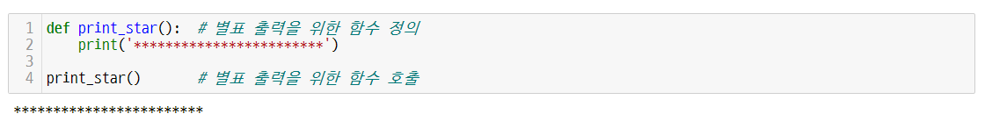
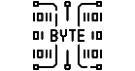
Key concept
UNIT 17
1. Basic Structure of Function
1.3. How to define and call functions essential in the program
Learn how to define a simple function and call it.
# Define a function to output an asterisk
# Call a function to output an asterisk
Line 1, 2, 4
In def print_star():, a function is defined using the def keyword. After writing the name of the function, add parentheses and colon :. A colon “:” means that a block of code follows. This is the same as for if, for, and while we learned in the previous unit.
The statements that make up the function are entered. The statements constituting the function must be indented. This chunk is called a block, and a function executes this block.
The 4th line is a statement that calls a function in the form of print_star() and executes it.

Slide 23
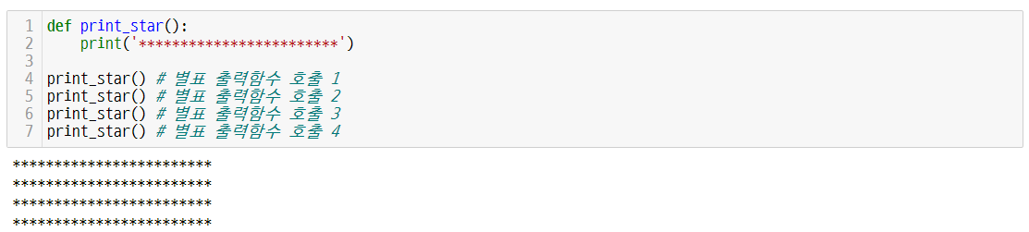
Key concept
UNIT 17
1. Basic Structure of Function
1.4. Call a function
The print_star function is a set or block of commands defined to do something. You can check that this set is executed every time it is called from the outside.
# Asterisk output function call 1
# Asterisk output function call 2
# Asterisk output function call 3
# Asterisk output function call 4
Line 1, 2
Define a print_star function that prints asterisk.
Lines 4 to 7 call the print_star function.

Slide 24
Key concept
UNIT 17
1. Basic Structure of Function
1.5. Advantages of functions
Advantages of functions based on what we have learned so far.
1. Structured programming is possible because one large program can be divided into several parts.
2. It is possible to reuse functions in other programs.
3. Code readability is increased.
4. Even when modifying a program, maintenance is easy because only some functions need to be modified.
5. If you use an already developed function, you can save time and money in program development.

Slide 25
Key concept
UNIT 17
2. Function Parameter
2.1. Key terms related to functions
Learn the key terms related to functions.
Parameter : It is a variable defined in the function or method header. It receives the actual value when the function is called.
Ex
m and n of def foo(m, n):
Argument : It refers to the actual value passed when a function or method is called. It is simply called an argument.
Ex
3 and 4 of foo(3, 4)

Slide 26


Key concept
UNIT 17
2. Function Parameter
2.1. Key terms related to functions
집중
When calling a function, it is the parameter that receives the actual value, and the actual value that is passed the value is called the argument.
Variables m, n with values 3 and 4 to be passed: parameters
def foo(m, n) :
code
…
return n1[, n2,…]
foo(3, 4)
Values to be passed to the function called foo 3, 4: Arguments

Slide 27
Key concept
UNIT 17
2. Function Parameter
2.1. Key terms related to functions
Example of a function that returns the sum of integers from 1 to 10
The following function calculates the sum of integers from 1 to 10 and returns it.
Variables start and end that can use the value passed in the function are called parameters.
The values 1 and 10 to be passed are called arguments.
A value is passed when calling a function.
end
def get_sum( , ) :
s = 0
for i in range(start, end+1) :
s += i
return s
start
1
10
x = get_sum( , )
The function does its job and returns the result with a return statement.

Slide 28
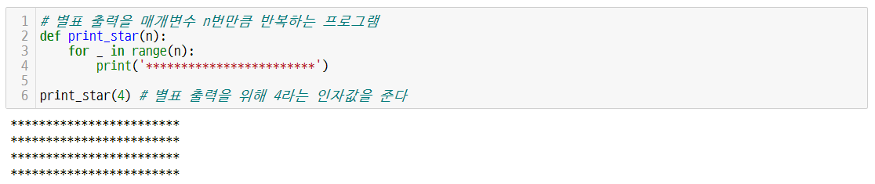
Key concept
UNIT 17
2. Function Parameter
2.2. Asterisk output function with parameters
Create an asterisk output function with parameters and call it with arguments.
With an argument of 4, the asterisk output can be repeated 4 times.
# Program that repeats the asterisk output for parameter n times
# Give the argument value of 4 for asterisk output
Line 2, 3, 4, 6
print_star takes the parameter n as input.
It loops n times in the for loop and prints a star.
Give the argument value 4 to print_star.

Slide 29
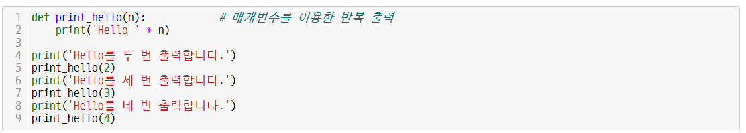
Key concept
UNIT 17
3. Parameter and Type Error
3.1. Case A using parameters
Control the number of times to output ‘Hello’ through the argument as follows. n inside the function is the parameter that receives the argument.
# Repeat output using parameters
('It prints Hello twice.')
('It prints Hello 3 times.')
('It prints Hello 4 times.')
It prints Hello twice.
Hello Hello
It prints Hello 3 times.
Hello Hello Hello
It prints Hello 4 times.
Hello Hello Hello Hello

Slide 30
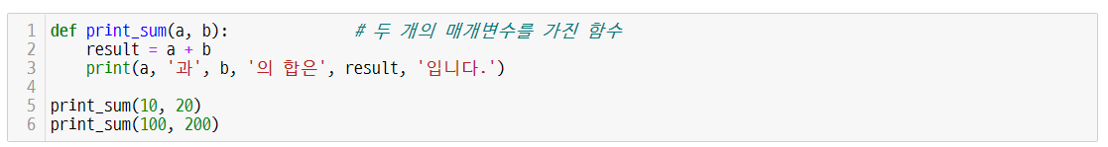
Key concept
UNIT 17
3. Parameter and Type Error
3.2. Case B using parameters
Find the sum of the argument values using parameters and print them.
The sum of arguments 10, 20, and 100, 200 can be calculated inside the function.
# Function with two parameters
('The sum of' a, 'and', b, 'is', result)
The sum of 10 and 20 is 30.
The sum of 100 and 200 is 300.
Line 1, 2, 3, 5
print_sum takes a and b as arguments.
Assigns the value of a + b to result and prints it.
It is called by putting 10 and 20 in print_sum.

Slide 31

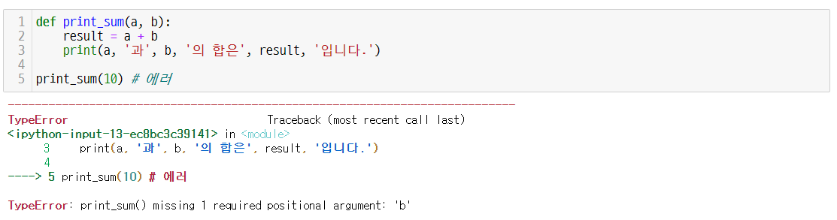
Key concept
UNIT 17
3. Parameter and Type Error
3.3. Parameter type error
If only one argument is given when calling a function, the TypeError message appears, and the function does not execute because there is no value of the parameter b required by the function.
Matching the number of arguments is very important.
TypeError
('The sum of' a, 'and', b, 'is', result)
# error
In this case, the number of arguments does not match.
('The sum of' a, 'and', b, 'is', result)
# error

Slide 32
Key concept
UNIT 17
4. Arbitrary Parameter
4.1. Arbitrary argument passing
Learn arbitrary argument passing.
When using a function, there are cases where the number of arguments is not determined. This is called an arbitrary argument.
When receiving an arbitrary argument from a function, put an asterisk (*) in front of the parameter. A variable inside a function that receives an arbitrary argument is an arbitrary parameter.
Arbitrary parameters can be used in for - in statements, like tuples and lists.

Slide 33
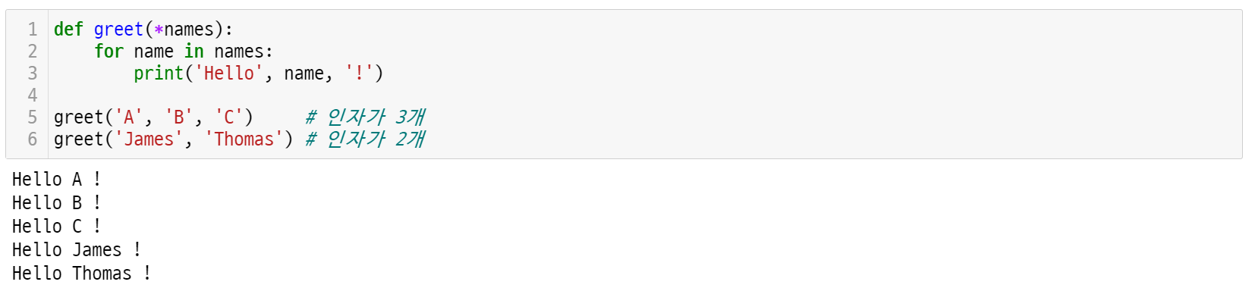
Key concept
UNIT 17
4. Arbitrary Parameter
4.1. Arbitrary argument passing
Create a function that works well even with 3 or 2 arguments through arbitrary argument passing.
# 3 arguments
# 2 arguments
Line 1, 2, 3
It takes an arbitrary argument called names.
Each element in names is printed using the for statement.

Slide 34
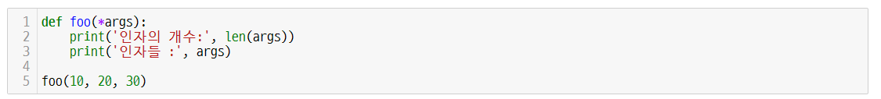
Key concept
UNIT 17
4. Arbitrary Parameter
4.1. Arbitrary argument passing
Count the number of arbitrarily passed arguments using the len function
It is also possible to print the number of arguments passed arbitrary as follows by using the len function.
('The number of arguments:', len(args))
('Arguments :', args)
The number of arguments: 3
Arguments : (10, 20, 30)
Line 1, 2, 3
It takes an arbitrary argument called args.
Print the number of args using the len function.
Print the elements of args.
Looking at the result, the arguments 10, 20, and 30 of the function are output in the form of a tuple.

Slide 35
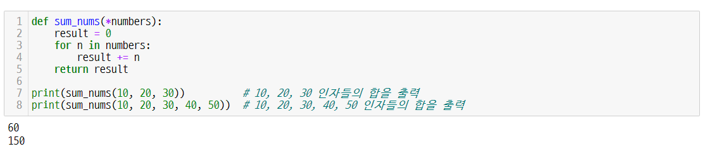
Key concept
UNIT 17
4. Arbitrary Parameter
4.2. Finding the sum of numbers entered as arguments
Create a program that finds the sum of the numbers entered as arguments.
If the number of arguments to be passed to the sum_nums function is not known in advance, all arguments can be received in a tuple format by using an arbitrary parameter called *numbers that takes arbitrary arguments.
# Print the sum of arguments of 10, 20, 30
# Print the sum of arguments of 10, 20, 30, 40, 50
Line 1, 2, 3, 4, 5
The sum_nums function takes an arbitrary parameter called numbers.
Through a for loop, the elements of numbers are stored in result.
Return result.

Slide 36
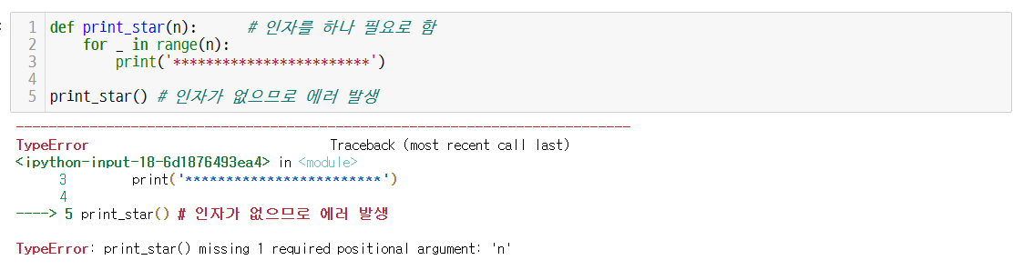
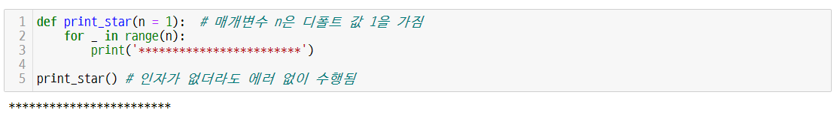
Key concept
UNIT 17
5. Default Parameter
5.1. Default parameters and robust programs
Create a robust program with default parameters. Why does the code below cause an error?
TypeError
# One argument required
# An error occurs because there is no argument
# An error occurs because there is no argument
# The parameter n has a default value of 1
If the default parameter value is set to 1 , no error occurs.
# Execute without error even if there is no argument

Slide 37
Key concept
UNIT 17
5. Default Parameter
5.2. Calling a function without arguments
Learn the case of calling a function without arguments.
In order to assign a specific task to a function, it is necessary to enter the correct argument. Sometimes, however, it is convenient to use the default value to prevent the error and work more flexible.
In this case, the default parameter is used.
As shown in the code below, you can assign a default value such as = 1 to a parameter.
# The parameter n has a default value of 1
# Execute without error even if there is no argument
Even if it is called without an argument, the default value of 1 is passed to the parameter n. Therefore, a single asterisk line is normally output.

Slide 38
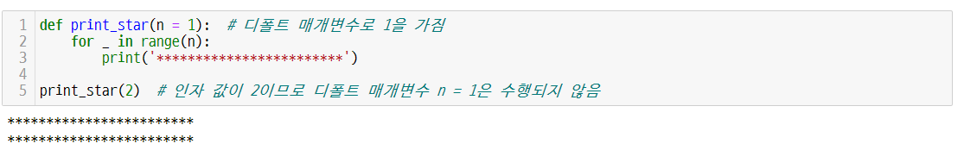
Key concept
UNIT 17
5. Default Parameter
5.2. Calling a function without arguments
Focus
If there is a value passed as an argument, the default value is not taken (if ignored).
If argument 2 is input when calling the print_star function, it does not take the default parameter 1, but takes the argument value 2 as the n value.
In this case, it outputs two asterisk lines. Default parameter 1 is ignored.
# The parameter n has a default value of 1
# Since the argument value is 2, the default parameter n=1 is not performed

Slide 39
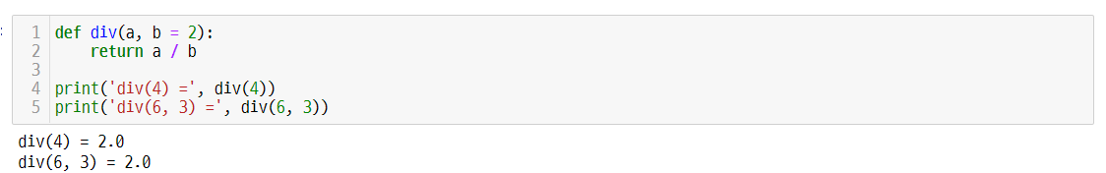
Key concept
UNIT 17
5. Default Parameter
5.3. Practice using default parameter
Create a function called div that takes two parameters.
Assign a default value of 2 to the second parameter.
Line 1, 2
a must receive an argument value, but b has already been assigned a default value of 2 even if it does not receive an argument value.
Returns a / b.
Since there is only 4 in the argument value, b is assigned as 2 (default value).

Slide 40
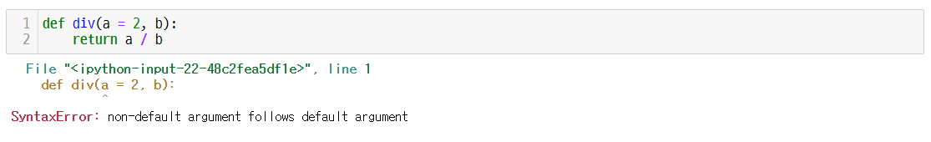
Key concept
UNIT 17
5. Default Parameter
5.3. Practice using default parameter
SyntaxError: non-default argument follows default argument
What if we assign a default value of 2 to the first parameter and skip the second parameter as follows?
Default parameters should be assigned to all variables or from the last variable in the order of appearance of the parameters.

Slide 41
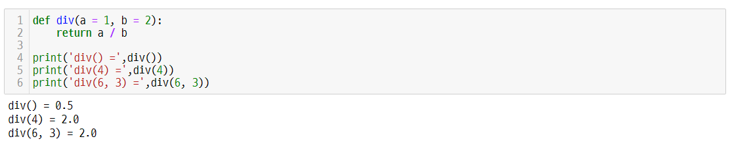
Key concept
UNIT 17
5. Default Parameter
5.3. Practice using default parameter
Learn the function call statement considering default parameters and the argument values
In the table below, div() is the same as div(1, 2). Blue 1 and 2 are default arguments. when calling a function, if empty, they are automatically given.
If div(4) is inserted, div(4, 2) is passed as an argument as shown in the table.
Function Call Statement | Arguments passed during actual execution (the blue argument is the default value) | Return Value
div() | div(1, 2) | 0.5
div(4) | div(4, 2) | 2.0
div(6, 3) | div(6, 3) | 2.0

Slide 42
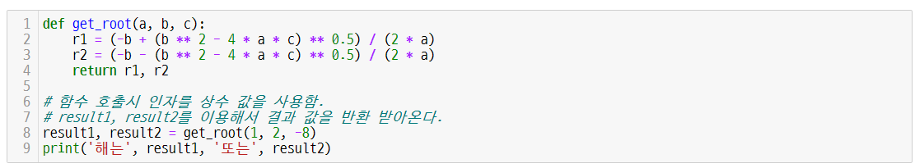
Key concept
UNIT 17
6. Keyword Parameter
6.1. Keyword parameters and argument passing method
Keyword parameter passing method
The default argument passing method in Python is called the positional argument method.
# When calling a function, use a constant value as an argument
# Return the result value using result 1 and result 2
('The result value is', result1, 'or', result2)
The result value is 2.0 or -4.0
Positional Argument Passing Method
def get_root(a, b, c):
function body
get_root(1, 2, -8)

Slide 43
Key concept
UNIT 17
6. Keyword Parameter
6.2. Necessity of keyword parameter
Learn why we need keyword parameter.
When calling a function, instead of passing only the value of the argument, the method of passing the argument by specifying the name is called a keyword parameter.
In the code below, if -8, 2, 1 is given as an argument, the result is different from when 1, 2, -8 is given as an argument.
('The result value is', result1, 'or', result2)
The result value is -0.25 or 0.5
Focus
When passing a value to a parameter, it is passed in the order a, b, c. In the positional argument passing method, the order in which the arguments are listed is important.

Slide 44
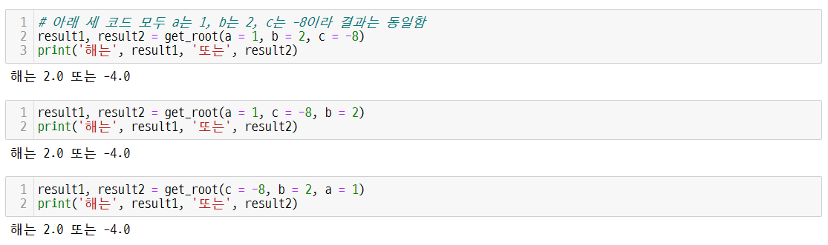
Key concept
UNIT 17
6. Keyword Parameter
6.3. Advantages of keyword parameters
Keyword parameters can be positioned anywhere.
The keyword parameter is a method where the argument value is determined by the keyword regardless of the position.
# All three codes below are a=1, b=2, c=-8, so the result is the same
('The result value is', result1, 'or', result2)
The result value is 2.0 or -4.0
('The result value is', result1, 'or', result2)
The result value is 2.0 or -4.0
('The result value is', result1, 'or', result2)
Positional Argument Passing Method
The result value is 2.0 or -4.0
def get_root(a, b, c):
function body
The result of codes above is all the same.
When keyword arguments are used, the position of the arguments is not important.
get_root(a=1, c=-8, b=2)

Slide 45
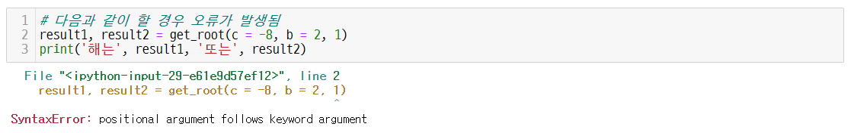
Key concept
UNIT 17
6. Keyword Parameter
6.4. Notes on using keyword parameters
Focus
Note the order of positional and keyword parameters.
When passing an argument to a Python function, there are two methods: a method of passing by a positional argument and a method of passing by a keyword argument. Also, there is a method to mix those two methods.
When mixing the two methods, the keyword argument must come after the positional argument.
SyntaxError: positional argument follows keyword argument
When a keyword argument and a positional argument are used together, the positional argument must come first. (If you do the following, an error will occur.)
# An error occurs when:
('The result value is', result1, 'or', result2)

Slide 46
Key concept
UNIT 17
6. Keyword Parameter
6.4. Notes on using keyword parameters
Mix keyword arguments and positional arguments
When using a mixture of keyword arguments and positional arguments, be sure to write the positional arguments first.
In the following case, the keyword argument value becomes -8 with c = -8. The remaining a and b values are passed in a positional argument method.
('The result value is', result1, 'or', result2)
The result value is 2.0 or -4.0
def get_root(a, b, c):
function body
get_root(1, 2, c = -8)

Slide 47

Key concept
UNIT 17
7. Return
7.1. A return statement that returns a result
Learn the return statement.
In general, it is assumed that the inside of a function is a black box.
The inside of a function has specific code. It can perform a given task and return a result.
The code below is an example of a Python function that returns one or more values using the return keyword.
def func_name([x1, x2, …]) :
code1
code2
…
return n1[, n2,…]
inputs
Function
Machine
outputs
After the function does its job,
function that returns the result

Slide 48
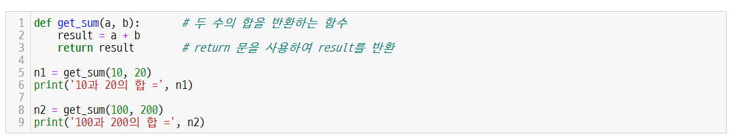
Key concept
UNIT 17
7. Return
7.1. A return statement that returns a result
Return result to get_sum function that returns the sum of two values
Let's put the sum of two numbers a and b into the result variable and return this result through the return statement.
n1 returns 30, the sum of 10 and 20, and n2 returns 300, the sum of 100 and 200.
# A function that returns the sum of two numbers
# Return the result using the return statement
('The sum of 10 and 20 =', n1)
('The sum of 100 and 200 =', n2)
The sum of 10 and 20 = 30
The sum of 100 and 200 = 300

Slide 49
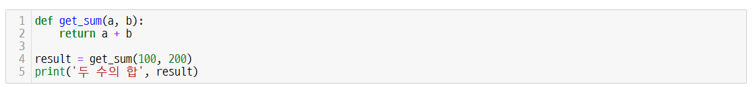
Key concept
UNIT 17
7. Return
7.1. A return statement that returns a result
Modify the get_sum function that returns the sum of two values
When returning a value using return, it is possible to return the result of the expression by entering an expression after the return keyword as follows.
Let's see how to use the get_sum function and return statement that returns the sum of two values.
('The sum of two numbers', result)
The sum of two numbers 300
The previous page and this page have the same result.

Slide 50
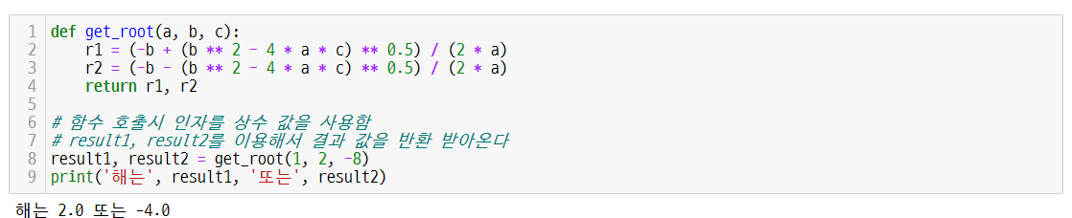
Key concept
UNIT 17
7. Return
7.2. A return statement that returns a tuple
Return two values as a tuple
Another way is to return two values as a tuple. In this case, the return value can be received in the form of a tuple from outside.
Returns the two roots r1 and r2 of the quadratic equation.
# When calling a function, use a constant value as an argument
# Return the result value using result 1 and result 2
Result1 and result2 receive the values of r1 and r2.
('The result value is', result1, 'or', result2)
The result value is 2.0 or -4.0
Line 2, 3
The quadratic formula is expressed in Python modifiers.
The quadratic formula is $\frac{−b±\sqrt{b^{2}−4ac}}{2a}$ .

Slide 51
Unit 17.
Function
Paper coding
Try to fully understand the basic concept before moving on to the next step.
Lack of understanding basic concepts will increase your burden in learning this course, which may make you fail the course.
It may be difficult now, but for successful completion of this course we suggest you to fully understand the concept and move on to the next step.

Slide 52
Paper coding
UNIT 17
Q1.
Define a function named my_greet that prints "Welcome." and call this function twice to print this greeting twice.
Condition for
Execution
Welcome.
Welcome.
Time
5 minutes

Slide 53
Paper coding
UNIT 17
Q2.
Implement the max2(m, n) function, which takes two parameters named m and n, and returns the larger of these two values, and the min2(m, n) which also takes two parameters named m and n and returns the smaller of these two values. Assign 100 and 200 as arguments and call two functions to check the results.
Condition for
Execution
The greater of 100 or 200 is : 200
The smaller of 100 or 200 is : 100
time
10 minutes

Slide 54
Paper coding
UNIT 17
We want to change the value of the mile, the unit mainly used in the United States, to the value of the kilometer, the international standard unit. Implement the mile2km(mi) function that takes a mile value as a parameter and returns it in kilometers and calls this function to output 1 to 5 miles as kilometers. In this case, use for - in range to make it repeatable. (Define 1 mile as 1.61 km.)
Q3.
1 mile = 1.61 kilometers
2 mile = 3.22 kilometers
3 mile = 4.83 kilometers
4 mile = 6.44 kilometers
5 mile = 8.05 kilometers
Condition for
Execution
Time
5 minutes

Slide 55
Paper coding
UNIT 17
Q4.
Implement the cel2fah(cel) function that takes a temperature in Celsius (Celsius) as a parameter and returns it in Fahrenheit. Then, call this function to change from 10 to 50 degrees Celsius in units of 10 degrees, and output it in Fahrenheit temperature as the following result.
10 degrees Celsius = 50.0 degrees Fahrenheit
20 degrees Celsius = 68.0 degrees Fahrenheit
30 degrees Celsius = 86.0 degrees Fahrenheit
40 degrees Celsius = 104.0 degrees Fahrenheit
50 degrees Celsius = 122.0 degrees Fahrenheit
Condition for
Execution
Time
5 minutes
conversion formula : Fahrenheit = Celsius × 9/5 + 32

Slide 56
Unit 17.
Function
Let’s code

Slide 57
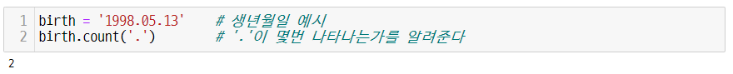
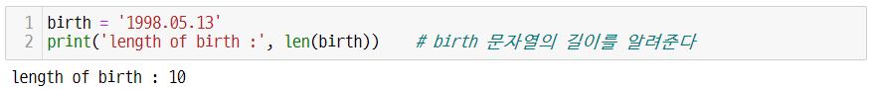
Let’s code
UNIT 17
1. String Processing
1.1. Various string processing functions and methods
Let's dive deeper into the string methods we learned in unit 14.
Learn the count method applicable to strings.
Also, let's get the length of a string using the len function.
The string count method returns the number of occurrences of a substring in a string.
# Date of birth example
# Tell you how many times '.' occurs
In addition to the methods mentioned above, built-in functions can also be applied to strings. The len function returns the length of a string.
# Return the length of the string birth

Slide 58
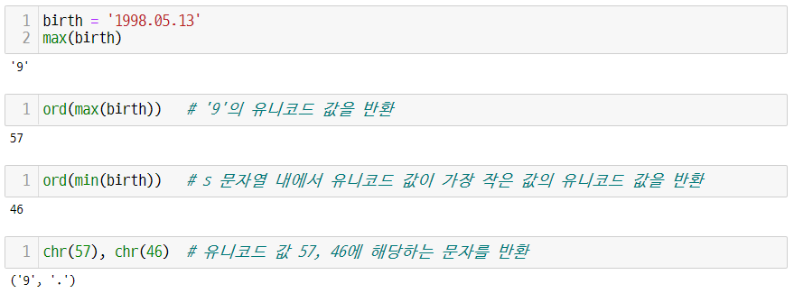
Let’s code
UNIT 17
1. String Processing
1.2. String processing using built-in functions
You can use the max and min functions to get the largest and smallest characters. The criterion of greater or lesser is based on the Unicode code value.
Unicode is an industry standard code system to defines characters that can be used in computers.
The ord function can get the Unicode value for a character, and the chr value returns the character corresponding to the input Unicode value.
# Return a Unicode value of 9
# Return the Unicode value of the smallest Unicode value within the string birth
# Return the character corresponding to Unicode values 57 and 46

Slide 59
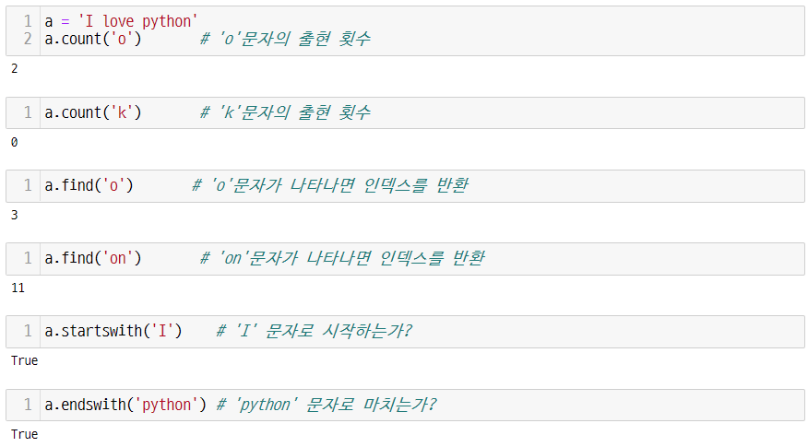
Let’s code
UNIT 17
1. String Processing
1.3. Various string methods
Learn various string methods and how to use them.
# Number of occurrences of the ‘o’ character
# Number of occurrences of the ‘k’ character
# Return the index when the ‘o’ character appears
# Return the index when the ‘on’ character appears
# Does it start with the character ‘I’?
# Does it end with the character ‘python’?

Slide 60
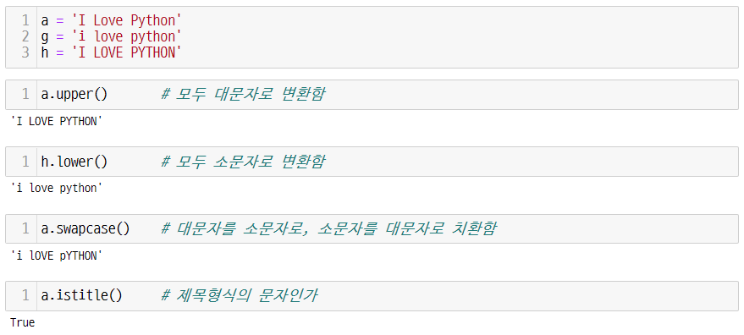
Let’s code
UNIT 17
1. String Processing
1.3. Various string methods
The string methods for uppercase/lowercase letters
# Convert all uppercase
# Convert all lowercase
# Convert uppercase to lowercase and lowercase to uppercase
# Is it a title text?

Slide 61
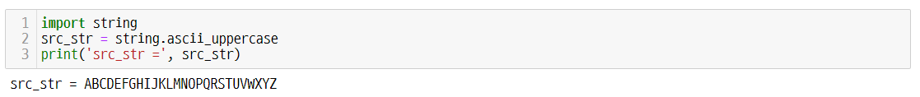
Let’s code
UNIT 17
1. String Processing
1.4. Using the string module
Print uppercase/lowercase letters using string module
Python has a module called string that helps with string processing. In this module, ascii_uppercase contains uppercase letters and ascii_lowercase contains lowercase letters.
Print the uppercase letters of the English alphabet using the string module.
The following is how to print lowercase letters of the alphabet.

Slide 62
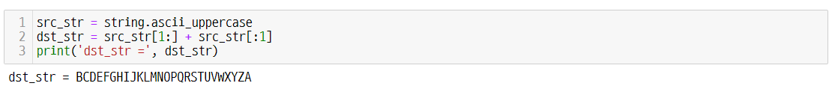
Let’s code
UNIT 17
1. String Processing
1.4. Using the string module
Try slicing the alphabet
If the string up to 'ABCDE..YZ' is moved one character at a time, what method should be used to create a string like 'BCDEF...ZA'?
In this case, we can solve this problem with the following simple slicing and addition operations.
Line 1, 2
Assign uppercase letters A to Z to src_str.
Add [:1], the letter A, to [1:], the string from B to Z. In this case, src_str[1:] + src_str[:1] is used to create concatenated characters.

Slide 63
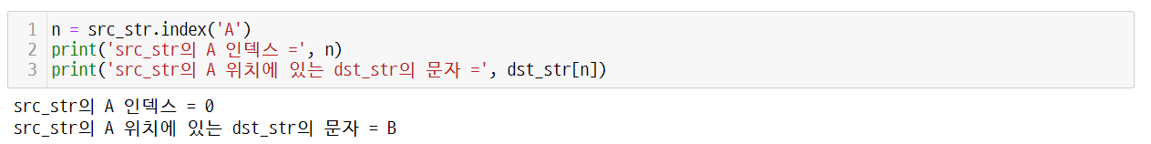
Let’s code
UNIT 17
1. String Processing
1.5. Using the index method
The position of the letter A in src_str can be asked with the following index method.
Conversely, if n obtained by using this index is searched for dst_str as an index, it can be confirmed that the letter of dst_str corresponding to position 'A' of src_str is 'B'.
('The index of src_str =', n)
('The character in dst_str at position A in src_str =', dst_str[n])
The index of src_str = 0
The character in dst_str at position A in src_str = B

Slide 64
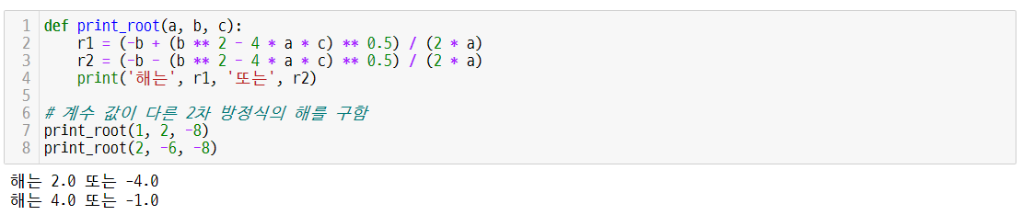
Let’s code
UNIT 17
2. Finding the Solution of a Quadratic Equation Using Parameters
2.1. Solutions of quadratic equations
If the coefficients of the quadratic equation are a, b, and c, respectively, the quadratic formula is as follows. Assume that a is non-zero here.
Enter the values corresponding to a(a != 0), b, and c according to the equation.
Let's find the solution when the coefficients are a, b, and c. Save this solution in variables r1 and r2 and print it out.
$$ax^{2}+bx+c=0$$
$$x=\frac{−b±\sqrt{b^{2}−4a}c}{2a}$$
('The solution is', r1, 'or', r2)
# Solve quadratic equations with different coefficient values
The solution is 2.0 or -4.0
The solution is 4.0 or -1.0
It receives three externally passed arguments as a, b, and c parameters, and performs quadratic formula operation in the function body. As a result, it is a function code that outputs r1 and r2.
Using functions makes the code much more concise and easier to use.

Slide 65
Let’s code
UNIT 17
3. Multiple Return Statement
3.1. A function that returns the area and perimeter of a circle
Use the radius of the circle to find the area and perimeter of the circle.
The circle_area_circum(radius) function is implemented to receive a radius 10 as an input and return two values, an area and a circumference.
def circle_area_circum(radius):
area = 3.14 * radius ** 2
circum = 2 * 3.14 * radius
return area, circum

Slide 66
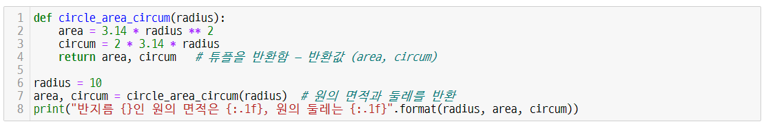
Let’s code
UNIT 17
3. Multiple Return Statement
3.1. A function that returns the area and perimeter of a circle
Return statements that return two or more values are called multiple return statements.
In multiple return statements, two values separated by a comma are returned as a tuple type.
# Returns a tuple - the return value (area, circum)
# Return the area and perimeter of a circle
("The area of a circle of radius {} is {:.1f}, and the circumference of the circle is {:.1f})".format(radius, area, circum))
The area of a circle of radius 10 is 314.0, and the circumference of the circle is 62.8
Line 1, 7-8
In the code above, the circle_area_circum function receives a radius as a parameter and returns two values corresponding to the area and circumference of the circle.
Outside the function of Line 7-8, the function circle_area_circum is called and the calculation result is stored in the variables area and circum and print them out.

Slide 67
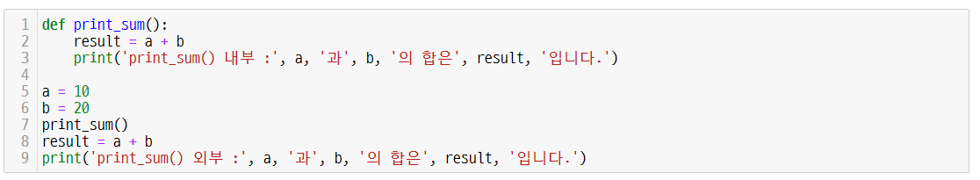
Let’s code
UNIT 17
4. Global Variable
4.1. The concept of global variables
Learn the term global variable.
A global variable is a variable declared outside a function and it is available to the entire code area.
If you look at the code and diagram below, you can see that the variables a and b are called and used in both the script file with the Python code and the print_sum function.
('print_sum() inside : the sum of', a, 'and', b, 'is', result)
('print_sum() outside : the sum of', a, 'and', b, 'is', result)
print_sum() inside : the sum of 10 and 20 is 30
print_sum() outside : the sum of 10 and 20 is 30
Global variables a and b can be used in the entire code.
a
10
a
b
20
b
Python
script file
print_sum function
using global variables

Slide 68
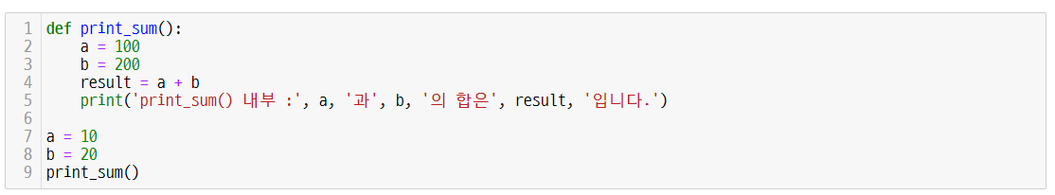
Let’s code
UNIT 17
4. Global Variable
4.1. The concept of global variables
Global Variables and Example Code
What if a global variable defined outside a function is changed inside the function?
Take a look at the code below. Inside the print_sum function, a and b were changed to 100 and 200, respectively.
('print_sum() inside : the sum of', a, 'and', b, 'is', result)
print_sum() inside : the sum of 100 and 200 is 300

Slide 69
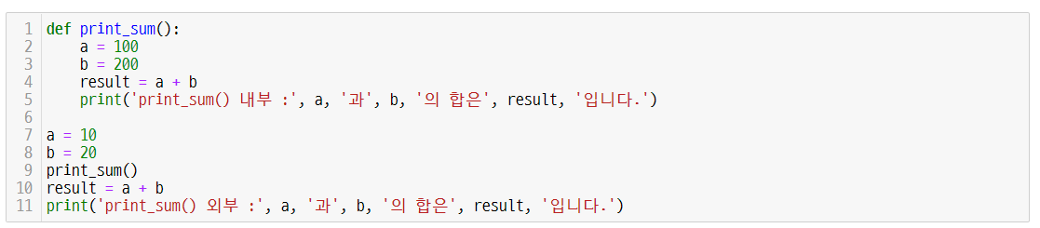
Let’s code
UNIT 17
4. Global Variable
4.1. The concept of global variables
Change of global variable and code to check
Change the global variable values a and b inside the function and execute the code to check the values externally.
Create new a and b variables referencing 100, 200
('print_sum() inside : the sum of', a, 'and', b, 'is', result)
Create variables a and b referencing 10 and 20
('print_sum() outside : the sum of', a, 'and', b, 'is', result)
print_sum() inside : the sum of 100 and 200 is 300
print_sum() outside : the sum of 10 and 20 is 30
After executing print_sum, add a and b once again outside the function, assign it to result, and print the result.
Were a and b changed to 100, 200 inside the function changed outside the function?
If you check the result, you can see that the a and b values inside print_sum are different from the a and b values outside the function.

Slide 70
Let’s code
UNIT 17
4. Global Variable
4.2. The concept of local variables
Focus
Results and interpretation of the previous code
The Python assignment statement is : a = 100, b = 200
Inside a function, this assignment statement creates a local variable.
Global variables a and b refer to global values 10 and 20.
Inside the print_sum function, a and b refer to the new objects 100 and 200.
As shown in the figure on the left, global variables a and b exist in the Python script file.
Variables a and b inside the print_sum function refer to a separate new object, not the object referenced by the global variable.
a, b refer to
10, 20
a, b refer to new object 100, 200
a
10
a
100
b
20
b
200
Python script file
print_sum function using local variables

Slide 71
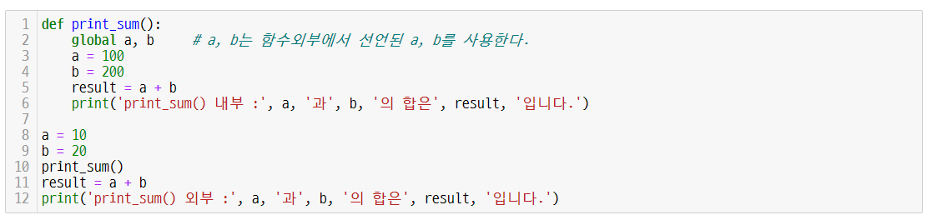
Let’s code
UNIT 17
4. Global Variable
4.3. global keyword
Learn how to refer to global variables using the global keyword.
Global variables a and b refer to 10 and 20
# a and b use a and b declared outside the function
Global variables a and b refer to 100 and 200
('print_sum() inside : the sum of', a, 'and', b, 'is', result)
('print_sum() outside : the sum of', a, 'and', b, 'is', result)
print_sum() inside : the sum of 100 and 200 is 300
print_sum() outside : the sum of 100 and 200 is 300

Slide 72
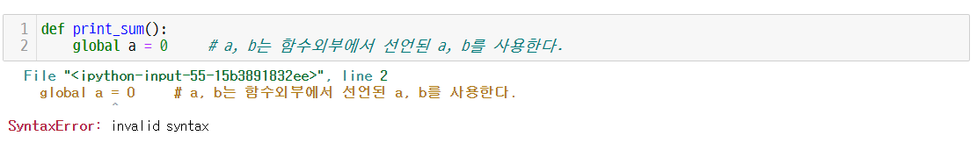
Let’s code
UNIT 17
4. Global Variable
4.3. global keyword
Beware of SyntaxError
# a and b use a and b declared outside the function
# a and b use a and b declared outside the function
Note: global a = 100 causes a syntax error. The global declaration and assignment operator cannot be used at the same time.

Slide 73
Let’s code
UNIT 17
4. Global Variable
4.4. Global variable reference process
The process of using global variables a and b in a function through an explicit global declaration is as follows.
Reference relation after declaring global a and b
a
10
a
print_sum function
b
20
b
Python script file
Inside the print_sum function,
results : a = 100, b = 200
The print_sum function is
using global variables
a and b change global variables
a
100
a
print_sum function
b
200
b
If you change the value of a variable declared as global a or b, the value is also changed outside the function.

Slide 74
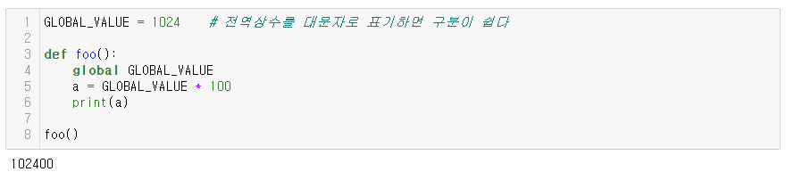
Let’s code
UNIT 17
4. Global Variable
4.5. Notes on using global constants in global variables
Global Variables vs. Global Constants
Using global variables is a very bad practice in all programming languages, not just Python. When the length of the code becomes long, global variables become the main cause of errors.
On the other hand, global constants are not necessarily bad.
A global constant is declared with the keyword global as follows. It can be declared outside of a function and referenced throughout the module. Global constant values are usually in uppercase.
A constant is a number that does not change.
Looking at the code below, after assigning a value of 1024 to a variable named GLOBAL_VALUE, it was declared as global GLOBAL_VALUE to call and use the value of this variable in the foo function.
# Capitalizing global constants makes them easier to distinguish

Slide 75
Let’s code
UNIT 17
5. Functions and Methods
5.1. Difference between function and method
Functions and methods are equivalent in that they perform a defined action to do a specific task. However, there is a difference between the two.
Function – A module in programming that receives parameters (optionally ignored) when called, performs a specific operation, and returns the result if necessary.
Method - A function attached to an object dealt with in object-oriented programming.
A method can call objects with different values, called instances.
This will be covered in class later.

Slide 76
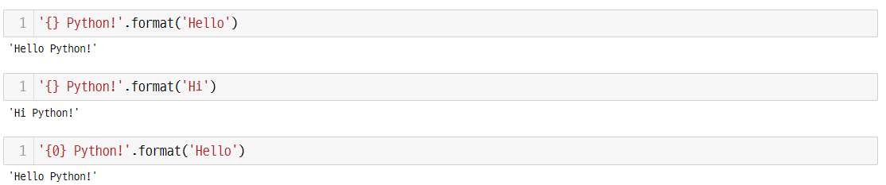
Let’s code
UNIT 17
5. Functions and Methods
5.2. format method
Learn how to do formatted output when outputting a string. Formatted output can be produced by calling the string method format.
Placeholder: Braces {} in a string used to output an argument are called a placeholder.
If you put an argument in the .format() method as follows, this argument value appears in the placeholder.
What goes into the placeholder
Placeholder : {}
This is called a base string or template string

Slide 77
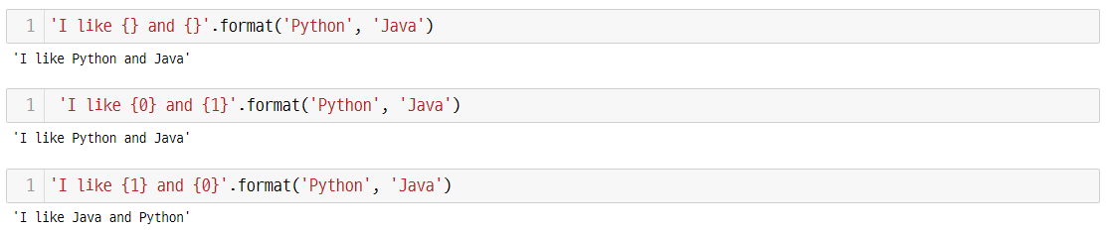
Let’s code
UNIT 17
5. Functions and Methods
5.2. format method
You can control the output order by assigning the required integer value (index) within the placeholder. (By default, 0, 1, .. are assigned.)
You can put index in placeholders with 0, 1, … etc. Depending on the index, Python or Java is entered, respectively.
‘I like {} and {}’.format(‘Python’, ‘Java’)
‘I like {0} and {1}’.format(‘Python’, ‘Java’)
‘I like {1} and {0}’.format(‘Python’, ‘Java’)
Role of placeholders and indexes

Slide 78
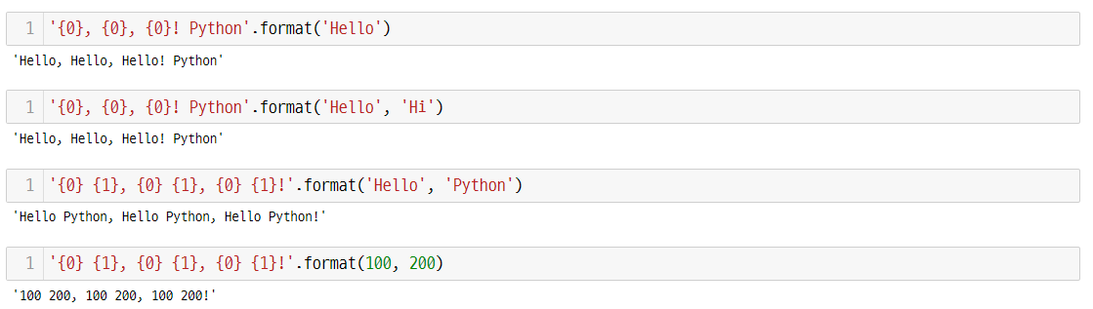
Let’s code
UNIT 17
5. Functions and Methods
5.2. format method
You can make various outputs by using the number of the placeholder, such as {0}, {1}, {2}.
A placeholder can be not only a string, but also an arbitrary data type such as an integer type like 100 or 200 or a real number type.
Let's take a look at the different output methods.
‘ {0}, {0}, {0}! Python’.format(‘Hello’, ‘hi’)
You can select an output value by putting an index in the placeholder.

Slide 79
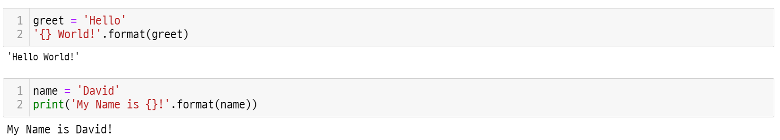
Let’s code
UNIT 17
5. Functions and Methods
5.2. format method
In format, you can put not only string literals (fixed values such as integers, strings, and Boolean data types), but also variables or objects as follows.
Line 1, 2
Enter the string ‘David’ in name.
If you enter a name using the format method, the name value is entered in {} (placeholder).

Slide 80
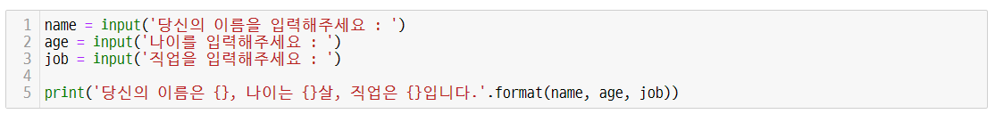
Let’s code
UNIT 17
5. Functions and Methods
5.2. format method
Ex
This is an example code that takes a user's name, age, and job as inputs, stores them in variables named name, age, and job, and outputs them using the format method.
('Enter your name : ')
('Enter your age : ')
('Enter your job : ')
('Your name is {}, age is {}, job is {}.', .format(name, age, job))
Enter your name : David
Enter your age : 23
Enter your job : Programmer
Your name is David, age is 23, job is Programmer.
The meaning of {} inside the print function means to print the argument value of the format function where {} is present.
Using the format method of a string, the name, age, and job are printed out in the {} fields, respectively.
If the format method is not used as above, the print statement appears in a complex form. In this case, there are too many commas and quotation marks, so it makes the code hard to read and causes errors.

Slide 81
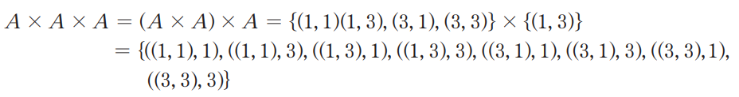
Let’s code
UNIT 17
6. Product Set
6.1. The concept of a product set
Learn a product set, the advanced topic of sets discussed in the previous section.
Let's see how to easily create a product set using a function.
The product set A3, a concept used in mathematics, can be defined as A x A x A.
A x A x A has the following elements.
The above operation can be implemented by repeating the product_set function.

Slide 82

Let’s code
UNIT 17
6. Product Set
6.1. The concept of a product set
Find the set of products using a function.
Review the product set discussed in the key concept of the previous unit once more.
# Product set using double for loop
# A function that performs powers on input_set
# res initialization
# Repeated for (exponent-1) to become a power
# Perform 3 powers on set A
Line 15
When an argument is passed in the exp function, exp calls product_set to perform a multiplication set. That is, the third power is performed.
Notes:
Key concept에 곱집합을 한 번 더 복습해보자.

Slide 83

Let’s code
UNIT 17
6. Product Set
6.2. The number of all possible outcomes when a die is rolled twice
Use the product_set function to count the number of cases in which a dice is rolled twice.
# Product set using double for loop
# Integers from 1 to 6 on the die
# Get product_set for case
Line 8, 9
The cases variable is assigned as a set type from 1 to 6.
Multiply the two cases. Then, the combination of two numbers is assigned as a set type. All cases are returned without duplicates.
Notes:
주석 부분을 잘 참고 해주세요.

Slide 84
Unit 17.
Function
Pair programming

Slide 85
Pair programming
UNIT 17

Slide 86
Pair programming
UNIT 17

Slide 87
Pair programming
UNIT 17
Q1.
Let the user input three integers a, b, and c. And print the average, maximum, and minimum values of these three numbers as follows. In this case, mean3(a, b, c), max3(a, b, c), min3(a, b, c) that takes three numbers as parameters and returns the average, maximum, and minimum values of these three numbers. Define and call each function.
Output Example
Enter three numbers : 9 2 6
The average value of 9, 2, 6 is 5.666666666666667
The maximum value of 9, 2, 6 is 9
The minimum value of 9, 2, 6 is 2

Slide 88
Unit 18.
Recursion Function Call

Slide 89
Unit learning objective
UNIT 18
Learning objectives
Understand and be able to use recursive functions.
Understand the concept of factorial and be able to implement factorial with iterative statements.
Be able to implement factorial and Fibonacci functions through recursive calls rather than loops.
Understand the shortcomings of recursive functions and be able to implement faster Fibonacci sequences through memoization.

Slide 90
Unit learning objective
UNIT 18
Lesson overview
Learn how to solve the problem by calling a function itself.
Learn how to implement factorial in a loop statement to check the efficiency of recursive functions.
Learn how to create a recursive function and call this function to find the factorial and Fibonacci numbers.
Learn the disadvantages and limitations of recursive calls, and how to implement the Fibonacci sequence in a better way through memoization.
Concepts You Will Need to Know From Previous Units
How to define and call user-defined functions using the def statement.
How to pass values to functions efficiently using variable parameters, default parameters, and keyword parameters.
How to return multiple values using the return statement of a function.

Slide 91
Unit learning objective
UNIT 18
Keywords
Recursive Call
Factorial
Fibonacci Sequence
memoization

Slide 92
Unit 18.
Recursion Function Call
Mission

Slide 93


Mission
UNIT 18
1. Real world problem
1.1. How do we make a fractal shape?
Humans have been using computers to solve complex and difficult problems.
There are still difficult problems in this world.
The figure on the left is a representative example of a fractal figure. A fractal is a natural phenomenon that exhibits features with repeated self-similarity. This fractal is being used to create natural images such as mountains and clouds in special effects of video.
Special effects in pictures can be created using these fractals.
It is a difficult problem to express such a fractal figure with computer code. However, there is a way to solve the problem through a technique called a recursion call.
https://www.mdpi.com/2504-3110/5/2/40/htm

Slide 94

Mission
UNIT 18
1. Real world problem
1.2. Tower of Hanoi problem
The Tower of Hanoi problem is a representative problem among the relatively easy ways to solve difficult problems using recursive methods.
The Tower of Hanoi is a game in which the disks shown in the picture are moved to other rods according to the rules.
When playing this game, there is an optimal number. If there are n disks, you can move all the disks by moving 2^𝑛 -1 times.
If you don't know the process, you'll have to move more than the optimal number.
Let's learn the process while making the Tower of Hanoi program.

Slide 95

Mission
UNIT 18
2. Solution
2.1. Solve the Tower of Hanoi puzzle
Tower of Hanoi is also a kind of puzzle game.
There are three rods and discs of various sizes that can fit on these poles. Before starting the puzzle, the discs are stacked on one rod in order with the smaller one on top.
The objective of the game is to move the disks stuck in one rod to the other rods in that order and build them again while satisfying the following four conditions.
There are four conditions for the game.
1. Move all n disks of different sizes from the starting point (A) to the ending point (C).
2. Only one disc can be moved at a time.
3. When moving a disk, remove the top disk of one rod and only move it to the top of the other rod.
4. In the process of moving the disc, a large disc cannot be placed on top of a small disc.
https://en.wikipedia.org/wiki/Tower_of_Hanoi
Notes:
동영상 파일입니다.

Slide 96
Mission
UNIT 18
2. Solution
2.1. Tower of Hanoi Puzzle Algorithm
To learn more about the Tower of Hanoi, visit https://en.wikipedia.org/wiki/Tower_of_Hanoi.
This is a very popular puzzle problem in computer science.

Slide 97

Mission
UNIT 18
3. Mission
3.1. Tower of Hanoi Puzzle Algorithm
If there is only one disk, it can be moved from the starting rod to the end rod in one turn.
Assume there are 3 disks and 3 rods.
1. In order to move the lowest disk 3 to the arrival rod, move 3-1 disks placed on it to the auxiliary rod.
2. Move Disc 3 to the arrival rod.
3. Move 3-1 discs from the auxiliary rod to the arrival rod.
We can solve this problem using a recursive method.
https://en.wikipedia.org/wiki/Tower_of_Hanoi

Slide 98

Mission
UNIT 18
3. Mission
3.2. Hanoi() function
('Number {}, {} -> {}' .format(n, from_, to_))
('Number {}, {} -> {}' .format(n, from_, to_))
In the function, the else statement solves the problem by calling hanoi() itself to move the disk.
This is the core code of the Hanoi function. Let's define the Hanoi function, put this code below, and print it out by inserting 3 disks. It is assumed that the names of the rods are ‘A’, ‘B’, and ‘C’.

Slide 99

Mission
UNIT 18
3. Mission
3.3. This is how the Tower of Hanoi works. (if n = 3)
('Number {}, {} -> {}' .format(n, from_, to_))
('Number {}, {} -> {}' .format(n, from_, to_))
Number 1, A -> C
Number 2, A -> B
Number 1, C -> B
Number 3, A -> C
Number 1, B -> A
Number 2, B -> C
Number 1, A -> C

Slide 100
Mission
UNIT 18
3. Mission
3.4. Programming plan
Pseudocode
Flowchart
Start
[1] Start
[2] Call the function hanoi(n, from_, to_, via_)
[3] if there is only one disk then { [4] Move the disk from from_ to to_}
[5] else { Move the (n-1) disks from from_ to to_ Call the function hanoi(n-1, from_, via_, to_)
[6] Move the largest disk n from_ to_ destination
[7] Move (n-1) disks in via_ to the destination
from_ is used as an auxiliary rod
Call the function hanoi(n-1, via_, to_, from_) }
[8] End
hanoi(n, from_, via_, to_)
if number_of_disks_to_move == 1
NO
YES
print( ‘Number {}, {} -> {}'.format(number_of_disks_to_move, from_, to_))
hanoi(number_of_disks_to_move-1, from_, via_, to_)
print(”Number {}, {} -> {}".format(number_of_disks_to_move, from_, to_))
hanoi(number_of_disks_to_move-1, via_, to_, from_)
End

Slide 101

Mission
UNIT 18
3. Mission
3.5. Tower of Hanoi final code
('Number {}, {} -> {}' .format(n, from_, to_))
('Number {}, {} -> {}' .format(n, from_, to_))

Slide 102
Unit 18.
Recursion Function Call
Key concept

Slide 103

Key concept
UNIT 18
1. Finding the Factorial with a Loop Statement
1.1. Definition of Factorial
Factorial is a term introduced from mathematics. It is expressed as n! for a natural number n.
The factorial is the product of all natural numbers from 1 to n when n is any natural number.

Slide 104

Key concept
UNIT 18
1. Finding the Factorial with a Loop Statement
1.2. Factorial and the for loop
Define and use a factorial with simple code without a return statement. The for loop can be used as follows.
('Enter a number : '))
Enter a number : 5
5! = 120
Line 3, 4
From 1 to n, the fact variable is multiplied by accumulating by i.

Slide 105
Key concept
UNIT 18
2. Finding the Factorial with a Recursive Function
2.1. What is a recursive function?
A recursion is a function that calls itself inside a function. Recursion is a very useful troubleshooting technique. It can intuitively and simply solve problems that are difficult to solve with procedural techniques.
Factorial expression and definition : n! = n * (n – 1)!, if n <= 1 : return 1
def factorial(5):
if n <= 1 :
return 1
else :
return n * factorial(n-1)
5 * factorial(4)
return 1 : This process is explained
on the next page
4 * factorial(3)
3 * factorial(2)
2 * factorial(1)

Slide 106
Key concept
UNIT 18
2. Finding the Factorial with a Recursive Function
2.2. The flow of recursive function
The flow of the factorial recursive function is as follows. Factorial(1) returns 1. By factorial(2), 2 * factorial(1) = 2 * 1 is returned. It has a flow, and the result of the iteration return is 120.
factorial(5)
return 5 * factorial(4) = 120
return 4 * factorial(3) = 24
return 3 * factorial(2) = 6
return 2 * factorial(1) = 2
1

Slide 107

Key concept
UNIT 18
2. Finding the Factorial with a Recursive Function
2.2. The flow of recursive function
Focus
In a recursive function, the termination condition is absolutely necessary.
By definition, the factorial is 1! = 1, n! = n*(n-1)! If this is implemented as a recursive function code, it can be expressed as follows.
# Implement recursive function of n!
# Termination condition is required
# n * (n-1)! implementation by definition
The key point in a recursive function is when the program ends.
By definition, 1! = 1, the value is defined, but there is no need to define a factorial for a value less than 1. If n is less than or equal to 1 in the if statement, 1 is returned.

Slide 108

Key concept
UNIT 18
One More Step
1. Recursion and Divide-and-Conquer Algorithm
In recursive calling, when a function calls itself and the size of the problem is n, it is common to call it by breaking it into smaller problems than n.
This solution method is closely related to the divide-and-conquer algorithm.
The divide-and-conquer algorithm can be also called multi-branch recursion. The factorial example shown earlier is not a divide-and-conquer algorithm because it is a one-branch recursive call where the recursive call is performed only once.
When the size of the problem is n, divide the problem into two by size n/2 and pass each as an argument to the recursive call, which will be a typical divide-and-conquer algorithm. In addition to splitting in half, the methods of applying recursive calls by splitting them into more than two small problems are all divide-and-conquer algorithms.
In a divide and conquer problem, there is a constraint that the sum of the divided problems must not be larger than the original problem.
If you learn data structures or algorithms later, you will learn a sorting algorithm called quick sort.
The sort algorithm can be implemented in a divide-and-conquer method using recursive calls.

Slide 109
Key concept
UNIT 18
3. Disadvantages of Recursive Functions and Memoization
3.1. Advantages and disadvantages of recursive functions and loop statements
Compare the pros and cons of recursive functions through the table below.
 | Recursive Functions | Loop Statements
Pros | Simple code | Fast
Cons | Use a lot of memory Slow | Complex code

Slide 110

Key concept
UNIT 18
3. Disadvantages of Recursive Functions and Memoization
3.2. Definition of the Fibonacci sequence
A Fibonacci sequence is a sequence in which the first and second terms are 1, and all subsequent terms are the sum of the two immediately preceding terms.
The first term $F_{0}$ of the Fibonacci sequence is 0, $F_{1}$ is 1, and $F_{n}$ is defined as follows.
$$F_{n}=F_{n−1}+F_{n−2}$$
According to this definition, the Fibonacci sequence is:
The Fibonacci sequence can create a geometric pattern as shown in the figure on the left.
0, 1, 1, 2, 3, 5, 8, 13, 21,...
Geometric pattern created by the Fibonacci sequence
https://shoark7.github.io/assets/img/algorithm/fibonacci-logo.png

Slide 111

Key concept
UNIT 18
3. Disadvantages of Recursive Functions and Memoization
3.2. Definition of the Fibonacci sequence
Define the Fibonacci sequence using a recursive function.
It is a structure that calls the Fibonacci function twice inside.
# A recursive implementation of the Fibonacci function
# Termination condition of the Fibonacci function
("How many Fibonacci numbers do you want?"))
# Cannot find Fibonacci number if it is negative
("Error : Enter a positive number.")
("Fibonacci sequence: ", end=' ')
How many Fibonacci numbers do you want? 5
Fibonacci sequence: 0 1 1 2 3

Slide 112

Key concept
UNIT 18
3. Disadvantages of Recursive Functions and Memoization
3.3. Fibonacci function execution process
Learn the execution process of Fibonacci function fib(5).
fib(5) calls fib(4) and fib(3), and fib(4) recursively calls fib(3) and fib(2). It results in a very large execution tree structure.
fib(5)
fib(4)
fib(3)
fib(3)
fib(2)
fib(2)
fib(1)
fib(2)
fib(1)
fib(1)
fib(0)
fib(1)
fib(0)
fib(1)
fib(0)
Called Function

Slide 113

Key concept
UNIT 18
3. Disadvantages of Recursive Functions and Memoization
3.4. Implementation of the Fibonacci function
The implementation of the recursive function of the Fibonacci sequence is as follows.
Line 7
The value is added as it is called recursively until the termination condition is met.

Slide 114

Key concept
UNIT 18
3. Disadvantages of Recursive Functions and Memoization
3.5. Efficiency of implementing the Fibonacci function as a recursive function
The biggest problem with the recursive function is that it is not efficient, because it repeats the calculation without meaning even if it is a value that has already been calculated. Let's look at the process of finding the 30th Fibonacci sequence as an example.
We will use the module for time measurement. Timer() provided by the time measurement module measures the execution speed of the statement entered as the first argument. For this, refer to the following timeit module manual. (https://docs.python.org/3/library/timeit.html )
It repeats the task of finding the 30th value 20 times and takes 9.7 seconds. (t3.timeit(number = 20) repeats 20 times)
If you write a higher value than this, it will probably take a longer time.

Slide 115
Key concept
UNIT 18
3. Disadvantages of Recursive Functions and Memoization
3.6. Fibonacci function and memoization
Focus
Memoization is a method of storing the results of small problems that are repeated over and over but the results do not change.
To solve the above problems, memoization in Dynamic Programming (DP) should be used.
Dynamic programming is one of the algorithm troubleshooting techniques to be dealt with during the algorithm course.
Key points :
In dynamic programming, you have to solve small problems to solve the big problems.
The results of those small problems is often constant.
Small problems that do not change the results occur repeatedly.
When a specific problem in which results are already recorded through memoization is repeated, unnecessary calculations can be skipped, and only recorded values can be retrieved very quickly.
A recursive function also has to solve small problems until a termination condition is met to solve a large problem, and there may be small problems that are repeated in the process.

Slide 116

Key concept
UNIT 18
3. Disadvantages of Recursive Functions and Memoization
3.6. Fibonacci function and memoization
This is an example of introducing memoization to the function fib(5) to find the Fibonacci number 5.
On the left is the case where 15 function calls were made without memoization. On the right, the number of function calls was reduced to 9 through memoization. Memoization can be implemented through a Python dictionary.
Called Function
Called Function
Memoization Function
Function call steps before memoization
Function call steps after memoization

Slide 117

Key concept
UNIT 18
3. Disadvantages of Recursive Functions and Memoization
3.7. The Fibonacci function and the principle of memoization
Focus
In order to prevent double-counting, if the values of the terms are stored as elements in dic, the values calculated once do not need to be re-calculated.
The code that introduces memoization to the function to find the nth Fibonacci number is as follows.
Declare a dictionary for memoization as a global variable, dic = {0:0, 1:1} Calling fibonacci_2(1) returns 1, which is dic[1]
# Import all classes and methods of timeit
If the dictionary already has a computed result, it returns the result and does not make a recursive call.
If the dictionary has no computed result, the function makes a recursive call. The call result is stored in a dictionary.
The code without memoization took 9.7 seconds, but the code with memoization took 0.000033 seconds.
If the efficiency of the recursive function is greatly reduced, it would be good to increase the efficiency by storing the result each time the recursive function is called. (memoization)

Slide 118
Key concept
UNIT 18
3. Disadvantages of Recursive Functions and Memoization
3.7. The Fibonacci function and the principle of memoization
Focus
Learn ​how dictionaries are updated.
The initial dictionary state : dic = {0:0, 1:1}
Call fib(2) : return fib(1) + fib(0)
Call of fib(2) : return dic[0] + dic[1], which becomes 1
dic = {0:0, 1:1, 2:1} state updated
Called Function
Memoization Function
Call fib(3) : return fib(2) + fib(1)
Function call steps after memoization
Call fib(3): return dic[1] + dic[2], which becomes 2
dic = {0:0, 1:1, 2:1, 3:2} state updated
...

Slide 119
Unit 18.
Recursion Function Call
Paper coding
Try to fully understand the basic concept before moving on to the next step.
Lack of understanding basic concepts will increase your burden in learning this course, which may make you fail the course.
It may be difficult now, but for successful completion of this course we suggest you to fully understand the concept and move on to the next step.

Slide 120
Paper coding
UNIT 18
Q1.
Let's take a number n as input and find the sum from 1 to n. Write this function using a recursive function call.
Condition for
Execution
Enter a number : 10
55
Time
5 minutes

Slide 121
Paper coding
UNIT 18
Q2.
Python has the ** operator, which indicates a square. However, let's take x and n as inputs without using an operator and use a recursive function to output x to the nth power. Let's try to output $2^{10}$ by inputting 2 as the x value and 10 as the n value as follows.
Condition for
Execution
Enter x : 2
Enter n : 10
1024
Time
5 minutes

Slide 122
Unit 18.
Recursion Function Call
Let’s code

Slide 123
Let’s code
UNIT 18
1. Built-in Functions
1.1. Built-in functions expressed as black boxes
We have been using functions such as print and input so far. We will learn more about this.
In programming, a function is often referred to as a black box.
This is because the user who calls the function only needs to provide the correct input value and use the resulting output (result value).
input 1
function
Black Box
input 2
Output
input 3

Slide 124
Let’s code
UNIT 18
1. Built-in Functions
1.1. Built-in functions expressed as black boxes
For example, since we know what the len function does for the string ‘ABCD’, we can use it without knowing the detailed operation process.
The print function and input function also belong to these functions.
Functions that are implemented by default in Python and provided are called built-in functions of Python.
Python provides over 100 built-in functions.
function
input
len()
output
‘ABCD’
4

Slide 125
Let’s code
UNIT 18
1. Built-in Functions
1.2. Python and built-in functions
Built-in functions in python
abs | dict | help | min | setattr
all | dir | hex | next | slice
any | divmod | id | object | sorted
ascii | enumerate | input | oct | staticmethod
bin | eval | int | open | str
bool | exec | isinstance | ord | sum
bytearray | filter | issubclass | pow | super
bytes | float | iter | print | tuple
callable | format | len | property | type
chr | frozenset | list | range | vars
classmethod | getattr | locals | repr | zip
compile | globals | map | reversed | _import_
complex | hasattr | max | round
delattr | hash | memoryview | set

Slide 126

Let’s code
UNIT 18
1. Built-in Functions
1.3. How to use built-in functions
Code that uses built-in functions does not require a separate import.
# A function that returns an absolute value
# A function that returns the minimum value among multiple elements
# A function that returns the maximum value among multiple elements
The abs function takes an integer of -100 and returns an absolute value of 100.
The min function returns the smallest value among integers with values of 200, 100, 300, and 400.
The max function returns the largest value among integers with values of 200, 100, 300, and 400.

Slide 127
Let’s code
UNIT 18
1. Built-in Functions
1.4. The return value of a built-in function
# Creates a string object in the format "FOO" or 'FOO‘
# Return the length of a string
# Return the type (type) of an object
# Return the ID value of an object
# Convert strings to numeric values and operators and evaluate them
The id function returns the identity of the variable str1 where the string “FOO” is stored.
The type function returns the data type of the corresponding variable.
The len function returns the length of the string stored in the variable str1.
The eval function receives a string, formulates the contents of the string, evaluates it, and returns the evaluated value.
Evaluates the string “100+200+300” as a Python statement, interprets it as 100+200+300, and returns 600.

Slide 128

Let’s code
UNIT 18
1. Built-in Functions
1.5. Built-in functions related to sorting
The code sorts a list of strings and integers in ascending and descending order.
# Sort string
# Sort the list in ascending order
# Sort the list in descending order
Line 1, 2
The sorted function receives a string and returns the characters that make up the string sorted in alphabetical order.
The sorted function also has a function to sort and return a list.
reverse = true to sort in descending order.

Slide 129

Let’s code
UNIT 18
1. Built-in Functions
1.6. The id function and object-oriented programming
The id function and object-oriented programming
Python is an object-oriented programming language.
The paradigm in which objects with various properties and functions compose a program is the core of object-oriented language.
Python objects have a unique identity that distinguishes them from other objects. The id function returns the object's identity as an integer. Objects will be dealt with in detail in Unit 21.

Slide 130

Let’s code
UNIT 18
1. Built-in Functions
1.7. type function
The type function returns the data type of an object. Learn the various data types in Python.

Slide 131

Let’s code
UNIT 18
1. Built-in Functions
1.8. eval function
This is an eval function where the Python interpreter executes the string value entered as an argument and outputs the result as it is.
The eval function is very powerful, such as executing the script itself.
It should be used with caution because it can directly call system commands to obtain information on all files in the system where Python is running, or even delete files.
# The Python translator executes the sentence of 10 + 20
# The Python translator executes the sentence of (5 * 20) / 2
# The Unicode value 65 is the alphabet ‘A’, which the chr() function returns
# Return the Unicode value 65 of the alphabet ‘A’

Slide 132
Let’s code
UNIT 18
2. Tower of Hanoi problem
2.1. Step-by-step execution process
Learn the step-by-step execution process of the Tower of Hanoi algorithm.
Solve the Tower of Hanoi problem using recursive functions.
Consider a simple case with three disks as shown in the figure. In the final stage, the largest disk (red disk) must go from A to C.
To do that, both the middle disk (blue disk) and the small disk (green disk) must go to B.
It should be considered to move the two disks to the destination B using the starting point A and the auxiliary rod C without considering the large disk.
When all the smaller disks have been moved to B, the largest disk is moved to C. [Figure 3]
In this case, there will be two small disks on rod B. [Figure 4]
After that, it should be considered to move the two small disks from the starting point B to the destination C using the auxiliary rod A. [Figure 5, 6, 7]

Slide 133
Let’s code
UNIT 18
2. Tower of Hanoi problem
2.1. Step-by-step execution process
When there is 1 disk,
1. Move directly from the starting point A to the destination C.
When there are 2 disks,
1. Move the small disk to B (as when there is only one disk).
2. Move the large disk to C (as when there is only one disk).
3. Move the small disk back to C (as when there is only one disk).
When there are 3 disks,
1. Move (disk 1, disk 2) from A to B using when there are 2 discs,
2. Move the disk 3 to C using when there is only one disk,
3. Move (disk 1, disk 2) from B to C using when there are two disks.

Slide 134
Let’s code
UNIT 18
2. Tower of Hanoi problem
2.2. Tower of Hanoi Algorithm
When there are n disks,
1. Move n-1 disks to B (as if there were n-1 disks).
2. Move the last disk to C (as if there is only one disk).
3. Move n-1 disks from B to C (as if there were n-1 disks).
If we implement this structure using a recursive function, it will be like this:
("Number {}, {} -> {}".format(n, from_, to_))

Slide 135
Unit 18.
Recursion Function Call
Pair programing

Slide 136
Pair programming
UNIT 18

Slide 137
Pair programming
UNIT 18

Slide 138
Pair programming
UNIT 18
Q1.
The natural number e, also called Euler's number or Napier's constant, is an irrational number used as the base of the natural logarithm. It is defined by the following formula.
( e = 1 + 1/1! + 1/2! + 1/3! + ..... + 1/n! )
In this formula, let k! be defined as a function named factorial(k). Also, let's define a function called euler(n) that returns the sum of 1/0! + 1/1! to 1/n! Find the value of euler(20) to five decimal places and output it as follows. (You must use a recursive function.)
Output example
eular(20) = 2.71828

Slide 139
Unit 19.
Lambda

Slide 140
Unit learning objective (1/3)
UNIT 19
Learning objectives
Utilize functionalized operations without def statements by using the lambda function.
Filter elements of certain conditions from lists by using the filter function.
Modify the value of elements from lists by using the map function.
Compute the accumulated total of multiple data by using the reduce function.

Slide 141
Unit learning objective (2/3)
UNIT 19
Learning overview
Learn the utilities of the lambda function, and how to define and call the lambda function.
Learn how to extract elements that satisfy a certain condition from a list by using the filter function.
Learn how to modify values of units in a list by using the map function.
Learn how to compute accumulated total from multiple data by using the reduce function.
Concepts You Will Need to Know From Previous Units
Understanding about functions and being able to explain built-in functions and user-defined functions
Using parameters to pass values to the called function
Generate lists and use list-related methods

Slide 142
Unit learning objective (3/3)
UNIT 19
Keywords
filter
map
reduce
lambda

Slide 143
Unit 19.
Lambda
Mission

Slide 144

Mission
UNIT 19
1. Real world problem
1.1. Digital content and copyright issues
21st century is the digital age and cultural age.
However, while creating digital content needs much time and effort, they are vulnerable to duplication and distribution.
Thus, protection of intellectual properties such as copyright is an important issue within the distribution stage of digital content.
Generally, the copyright of a book lasts until 50 or 70 years after demise of the author though it is slightly different by countries.

Slide 145

Mission
UNIT 19
1. Real world problem
1.2. Sherlock Holmes Series
Sherlock Holmes series written by Arthur Conan Doyle is famous world-wide.
This series consists of A Study in Scarlet (1887) – The Sign of the Four (1890) – The Adventures of Sherlock Holmes (1892) – The Memoirs of Sherlock Holmes (1894) – The Hound of the Baskervilles (1901) – The Return of Sherlock Holmes (1905) – The Valley of Fear (1915) – His Last Bow (1917) – The Case-Book of Sherlock Holmes (1927)
We will receive dates in the form 1887.11.20 and parse this list. Parsing is task that analyzes list or syntax of data.
Write a program that verifies, based on parsing, whether the input year is the publication year by Conan Doyle.

Slide 146

Mission
UNIT 19
1. Real world problem
1.2. Sherlock Holmes Series
It is a detective novel series written by Conan Doyle with Sherlock Holmes as the main protagonist.
This series introduced the genre called detective novel to the world, and this is the first and most representative series of the golden age of detective novels that began in England.
The protagonist Sherlock Holmes is a character with many talents in botany, geology, chemistry, anatomy, music, law, and sports.

Slide 147

Mission
UNIT 19
1. Real world problem
1.2. Sherlock Holmes Series
Visit https://en.wikipedia.org/wiki/Sherlock_Holmes to find out more about Sherlock Holmes.

Slide 148

Mission
UNIT 19
2. Mission
2.1. Parse dates to compare with the publication year of the Sherlock Holmes series
Receive the year, month, and date from the user and verify if this year is the publication year of Sherlock Holmes series.
The input of the user if in the form of 1887.11.20
Construct a function that prints “This is not a publication year of the Sherlock Holmes series” if the year entered by the user is not the publication year of the Sherlock Holmes series.
Construct a lambda function named is_sherlock_book_y that verifies if the input year is the publication year.
In addition, we will check if the month and date entered by the user was correctly given.
For example, 1915.5.3 is a correct input, but 1915.5.33 is not. Thus the program must print “The date is incorrect.”

Slide 149

Mission
UNIT 19
2. Mission
2.2. Construct Sherlock Holmes
('This is not a publication year of the Sherlock Holmes series.')
('The month is incorrect.')
('The date is incorrect.')
('Distinguish year, month and date by .(e.g. 1917.6.10) : ')
('This is the publication date of a Sherlock Holmes series!')
('This is not the publication date of a Sherlock Holmes series or the input has an error.')
Distinguish year, month and date by . (e.g. 1917.6.10) : 1927.9.10
This is the publication date of a Sherlock Holmes series!

Slide 150
Mission
UNIT 19
2. Mission
2.3. Programming Plan (valid_date function)
Pseudocode
Flowchart
Start
[1] Start
[2] Store publication years of the Sherlock Holmes series in a list
[3] Receive dates as an input from the user
[4] if the input date is not a publication year, then { [5] return False with print statement and exit.}
[6] if the month is incorrect then { [7] return False with print statement and exit.}
[8] if the date is incorrect then { [9] return False with print statement and exit.}
[10] End
sherlock_series = [ 1887, …. ]
date = input
if not is_sherlock_book_yr(year)
print(‘This is not a publication year of the Sherlock Holmes series.’) return False
NO
if month < 1 or month > 12 :
YES
NO
print(‘The month is incorrect.’)
return False
if day < 1 or day > days[month-1]:
print(‘The date is incorrect.')
return False
End

Slide 151
Mission
UNIT 19
2. Mission
2.4. Sherlock Holmes program final code
('This is not a publication year of the Sherlock Holmes series.')
('The month is incorrect.')
('The date is incorrect.')
('Distinguish year, month and date by .(e.g. 1917.6.10) : ')
('This is the publication date of a Sherlock Holmes series!')
('This is not the publication date of a Sherlock Holmes series or the input has an error.')

Slide 152
Unit 19.
Lambda
Key concept

Slide 153
Key concept
UNIT 19
1. Lambda Expression
1.1. Lambda expression or lambda function syntax
Define a def statement to return the sum of the parameters x, y by writing a function called add as shown below.
Creating a function with def add:, writing the body, and assigning the return value with return statement may be cumbersome.
In Python, you can create a function for one-time use that encompasses all these steps. This is called a lambda function.
The lambda function is a function without a name and is also called a lambda expression. Due to such characteristic, it is also called an anonymous function.
Comparison of a regular function and a lambda function : A regular function consists of def keyword, name of the function, parameters, colon, and the body while a lambda function only has the functionalities of parameter and function.
parameter
매개변수
regular function
lambda function
일반 함수
람다 함수
def add(x, y):
return x + y
lambda x, y : x + y
function body
함수 몸체

Slide 154
Key concept
UNIT 19
1. Lambda Expression
1.1. Lambda expression or lambda function syntax
Understand how to define a lambda function and pass an argument. Define lambda as a keyword and insert arguments in the bracket.
The syntax of the lambda function is simple as follows. The expression consists of [parameters] and colons(:).
lambda [parameter 1, parameter 2, ...] : [expression]
(lambda [parameter 1, parameter 2, ...] : [expression])(argument 1, argument 2, ...)
lambda [parameters] : {expression}

Slide 155

Key concept
UNIT 19
1. Lambda Expression
1.2. Syntax of regular function
Ex
Example of a code that returns a sum of integers using the add function.
# addition using add() function
('sum of 100 and 200 :', add(100, 200))
sum of 100 and 200 : 300
Although the function executes a simple operation that adds two numbers, the code must follow all syntax including def keyword, function name, function body, and return.

Slide 156

Key concept
UNIT 19
1. Lambda Expression
1.3. Syntax of regular function and lambda function
Use a lambda function to execute what the add function does without defining the function.
Define lambda function with the keyword lambda. The expression receives x, y as parameters and returns x + y.
The function adds two arguments without a head like def add(x, y):
Now substitute the add variable with the anonymous function lambda. This executes an addition operator with 100, 200 as parameter inputs.
This verifies that the lambda function successfully performs tasks of functions carried out by regular functions.
# addition using the lambda function
('sum of 100 and 200 :', add(100, 200))
sum of 100 and 200 : 300

Slide 157
Key concept
UNIT 19
1. Lambda Expression
1.3. Syntax of a regular function and a lambda function
Lambda function operates well even with such simple statement. Even the add variable is not necessary.
('sum of 100 and 200 :', (lambda x, y: x + y)(100, 200))
sum of 100 and 200 : 300
Line 1
Lambda function executes x + y and returns the values.
Passes arguments 100, 200 to the parameters x and y.

Slide 158

Key concept
UNIT 19
1. Lambda Expression
1.3. Syntax of a regular function and a lambda function
The lambda function enables simple coding.
The map function, which you will learn in the next chapter, is used like the lambda expression. It shows great performance with simple coding.
The code above is a lambda expression and a map function that return x square.

Slide 159
Key concept
UNIT 19
2. filter, map, reduce
2.1. Syntax of filter function
Python offers functions of numerous forms. filter function is one of them.
filter function receives iterable elements and returns only those that are True in a bundle.
The syntax of the filter function is as follows.
filter((Tobeapplied_function, {iterable object})

Slide 160

Key concept
UNIT 19
2. filter, map, reduce
2.2. Application example of a filter function
Ex
There is a list that stores ages of many people. Build a code that extracts ages of adults above 19.
# return True for values over 19, and False for those that are not.
('adults list :')
# filter ages by using filter () function
Adults list :
34 39 20 54
Line 1 - 6
adult_func function returns True if the value of the variable n is above 19 and False if the value is below 19. The variable n is a parameter that signifies age.

Slide 161
Key concept
UNIT 19
2. filter, map, reduce
2.2. Application example of a filter function
Ex
There is a list that stores ages of many people. Build a code that extracts ages of adults above 19.
# return True for values over 19, and False for those that are not.
('adults list :')
# filter ages by using filter () function
Adults list :
34 39 20 54
Line 8 - 11
ages list contains random values of age. The code put adult_fuc function and iterable list variable ages as arguments.
The filter function passes units of ages to adult_func function one by one and returns a list that only contains units that returned True.
You can see that 18, 13 from the ages variable are not printed.

Slide 162
Key concept
UNIT 19
2. filter, map, reduce
2.3. Characteristics of filter function adult_func
The adult_func function has following characteristics.
In such case where the functionality is simple and reuse is not necessary, lambda function is appropriate.
The algorithm is relatively simple. It does not need an extra inner variable. You do not need to reuse it once it filters adults list.

Slide 163

Key concept
UNIT 19
2. filter, map, reduce
2.3. Transform adult_func filter function to lambda function
You can simplify the adult_func function by transforming it to an anonymous function by using the lambda keyword.
Using the lambda function as follows, the code became much simpler and shorter.
('adults list :')
# filter ages using filter () function
adults list :
34 39 20 54
Line 3
It returns True for x equal to or over 19, and only prints values of ages that are equal to or over 19.
The filter condition is lambda x: x>= 19.

Slide 164

Key concept
UNIT 19
2. filter, map, reduce
2.4. Operating procedure of lambda function used in filter function
The below diagram describes the operating procedure.
The code is much simpler and shorter because it used a one-line lambda function instead of adult_func function.
[34, 39, 20, 18, 13, 54]
lambda x: x >= 19
Condition of the filter function
ages list
34
39
20
18
13
54
filter
x: x >= 19 filter
filter
34
39
20
54
[34, 39, 20, 54]
The behavior of the filter function and the role of the lambda function
Iterable objects and returned values of the filter function

Slide 165
Key concept
UNIT 19
2. filter, map, reduce
2.5. Application of the lambda function
Observe the behavior of the lambda function which acts as a filter.
A filter function with a specific condition filters units from the input list [34, 39, 20, 18, 13, 54]. It passes units equal to or above 19, and filters units below 19.
This lambda function returns True or False according to the result discerned by the condition expression x >= 19 on x of lambda x: .
The filter function receives filter condition function and iterable object as parameters.

Slide 166
Key concept
UNIT 19
2. filter, map, reduce
2.6. map function
Python offers a built-in function called map. This function returns an iterable datatype by applying mapping function on each unit of the iterable datatype.
Consider a case where you return a list of [1, 4, 9, 16, 25, 36, 49] by applying square operation on each value of a list called a, which is [1, 2, 3, 4, 5, 6, 7].
a
1
2
3
4
5
6
7
x**2
1
4
9
16
25
36
49

Slide 167

Key concept
UNIT 19
2. filter, map, reduce
2.7. Computing square value of all units in the list
Ex
If the elements of list a are as follows, add the square value of units of a to the list.
Solve the problem with methods we already know.
Execute square operation on each unit x of list a by using the for statement. Then, add this value to a list called square_a by using append method.
# add n square to list square_a
Line 3, 4
Sqaure each units of a and add to list square_a

Slide 168

Key concept
UNIT 19
2. filter, map, reduce
2.8. Behavior of map function
You can easily modify the previous code by using map function and square function. The syntax of map function is as follows. The iterable objects are objects such as list or tuple, which will be discussed later.
map(function_to be applied , iterable object, ...)
The map function takes two or more arguments. The first is a mapping function and the second is an iterable object such as a list that will be inserted to the mapping function.
By using the map function, each value in the iterable object like a list is applied on the mapping function and returns list [1, 4, 9, 16, 25, 36, 49] which has square values of [1, 2, 3, 4, 5, 6, 7]
# apply the return value of square function to each term of a

Slide 169
Key concept
UNIT 19
2. filter, map, reduce
2.9. Combination of map function and lambda function
Expressing a simple code using the map function and the lambda function
You can simplify the code by using the map function and lambda function. The lambda function operates as one-time function. It is efficient than externally writing a def statement to define a function.
Line 2
In the map function there are the lambda function which returns x square and the list a.
Each square value of elements of a is stored in square_a in list type.

Slide 170

Key concept
UNIT 19
2. filter, map, reduce
2.9. Combination of map function and lambda function
You can transform units of the list into a simple expression by using the map function and lambda function.
a
1
2
3
4
5
6
7
x**3
1
8
27
64
125
216
343

Slide 171
Key concept
UNIT 19
2. filter, map, reduce
2.10. iterable data types and filter, map function
Python offers built-in functions called filter and map. Apply mapping function on each element of an iterable data type.
These functions return iterable objects. This object can be modified into a list type by using the list function.
iterable object
(list, tuple, range etc.)
item 1
item 2
item 3
item 4
…
item n
filter, map function
in some cases, m $≠$ n
iterator object returned by mapping or filter
item 1
item 2
item 3
…
item m

Slide 172
Key concept
UNIT 19
2. filter, map, reduce
2.10. Iterable data types and filter, map function
iterable object
(list, tuple, range etc.)
item 1
item 2
item 3
item 4
…
item n
filter, map function
in some cases, m $≠$ n
iterator object returned by mapping or filter
item 1
item 2
item 3
…
item m
Each item of iterable data types such as list, tuple, range etc. are modified by mapping functions like filter or map and returned. Each value is an iterator object, and these objects can be modified back into an iterable data type by using data type modifier function such as list.

Slide 173
Key concept
UNIT 19
2. filter, map, reduce
2.10. Iterable data types and filter, map function
Focus
Using a lambda function on the filter and map accelerates execution by reducing function call overhead.
Why do you filter and map each item of iterable data types such as list, tuple, range etc. by using functions such as filter and map?
Such task can be done by function call, but too much function call produces has a shortcoming. During function call, it saves the state before the call, and after the call, it restores the previous state, and frequent execution of this process is a problem.
This slows down the program operating speed.

Slide 174

Key concept
UNIT 19
2. filter, map, reduce
2.11. reduce function
Reduce function is included in a module called functools. This returns a single value by executing an operation with a given function on items of an iterable object.
Examine the following exercise. With a list called seq = [], the reduce (func, seq) function executes the following procedure.
[ S₁, S₂, S₃, S₄ ]
func(S₁,S₂)
func(func(S₁,S₂),S₃)
func(func(func(S₁,S₂),S₃),S₄)

Slide 175
Key concept
UNIT 19
2. filter, map, reduce
2.11. reduce function
The first and second item of list seq, s1 and s2, are given as inputs of func function, which acts as a parameter of reduce function. Then a certain value is returned to func (, ), which is then given as input for the func function with the next item of seq, s3.
In expression, it is func(func(, ), ). This process is recursively iterated until the last item is given as an input.
In the end it returns a single value.
[ S₁, S₂, S₃, S₄ ]
func(S₁,S₂)
func(func(S₁,S₂),S₃)
func(func(func(S₁,S₂),S₃),S₄)

Slide 176

Key concept
UNIT 19
2. filter, map, reduce
2.12. Example of reduce function
Ex
Example using the reduce function
1, 2, 3, 4 are give as items of list variable a.
First, 3 is returned form lambda function lambda x, y: x+y when the first two values 1, 2 are given as inputs.
Then, the return value 3, with the third item 3, is given an input value for the lambda function. It then returns 6, the sum of the two numbers, then this value 6 and the last item 4 are given as input for the lambda function, thus returning the final value 10.
(((1 + 2) + 3) + 4) => returns 10

Slide 177
Unit 19.
Lambda
Paper coding
Try to fully understand the basic concept before moving on to the next step.
Lack of understanding basic concepts will increase your burden in learning this course, which may make you fail the course.
It may be difficult now, but for successful completion of this course we suggest you to fully understand the concept and move on to the next step.

Slide 178
Paper coding
UNIT 19
Q1.
There is a list with integer element values called n_list = [1, 2, 3, 4, 5, 6, 7, 8, 9, 10]. Return even_list which only contains items of even number values from n_list by using the filter function and the lambda function.
The returned even_list = [2, 4, 6, 8, 10]
Conditions
for Execution
even_list = [2, 4, 6, 8, 10]
Time
5 Minutes
Create an empty list named even_list and add even value items by the append method. Use the for statement and the filter function. Use lambda function inside the filter function.

Slide 179
Paper coding
UNIT 19
Q2.
There is a list with integer unit values called n_list = [1, 2, 3, 4, 5, 6, 7, 8, 9, 10]. Return even_list which only contains items of even number values from n_list by using a lambda function. This time, do not use for statement, and instead use list function.
Returned even_list = [2, 4, 6, 8, 10]
Conditions
for Execution
even_list = [2, 4, 6, 8, 10]
Time
5 Minutes
Modify objects returned by the filter function to list objects by the list function, and assign them to even_list.
Write the entire code and the expected output results in the note.

Slide 180
Paper coding
UNIT 19
Q3.
Write a map function that converts a_list which contains lowercase alphabets like [‘a’, ‘b’, ‘c’, ‘d’] to a upper_a_list which contains upper case alphabets like [‘A’, ‘B’, ‘C’, ‘D’].
Also, define a function named to_upper that receives lowercase letters as parameters and returns uppercase letters, and convert those lowercase letters.
Conditions
for Execution
upper_a_list = ['A', 'B', 'C', 'D']
Time
5 Minutes
Write the entire code and expected output result.

Slide 181
Paper coding
UNIT 19
Q4.
Compute the sum of integers from 1 to 100 by using reduce function and lambda expression inside it. Use range (1, 101) as an input.
Condition for
Execution
Sum of 1 to 100 : 5050
Time
5 Minutes

Slide 182
Unit 19.
Lambda
Let’s code

Slide 183



Let’s code
UNIT 19
1. Exception Handling
1.1. Importance of exception handling
A programmer must code in preparation of exceptions. A code below is in the danger of termination due to an incorrect input. Enclose the code with try ~ except statement.
('Enter two numbers : ').split()
('Check if the numbers are correct.')
Enter two numbers : 10 2
10/2 = 5.0
It behaves as intended for correct inputs.
('Enter two numbers : ').split()
('Check if the numbers are correct.')
Enter two numbers : 100 two
Check if the numbers are correct.
Enter two numbers : 100 two
Check if the numbers are correct.
except statement processes the code even though the user entered a string ‘two’.
If the user enter 100 and 0, the code tries 100/0. The except statement handles the exception.

Slide 184
Let’s code
UNIT 19
1. Exception Handling
1.2. Various Exceptions
BaseException Exception ArithmeticError FloatingPointError OverflowError ZeroDivisionError AssertionError AttributeError BufferError EOFError ImportError ModuleNotFoundError LookupError IndexError KeyError MemoryError NameError | ProcessLookupError TimeoutErrorReferenceError RuntimeError NotImplementedError RecursionError StopIteration StopAsyncIteration SyntaxError IndentationError TabError SystemError TypeError ValueError UnicodeError UnicodeDecodeError UnicodeEncodeError UnicodeTranslateError | UnboundLocalError OSError BlockingIOError ChildProcessError ConnectionError BrokenPipeError ConnectionAbortedError ConnectionRefusedError ConnectionResetError FileExistsError FileNotFoundError InterruptedError IsADirectoryError NotADirectoryError PermissionError FutureWarning ImportWarning
What kinds of exceptions are there?
The table shows many cases of exceptions.
These exceptions will be studied later.

Slide 185

Let’s code
UNIT 19
1. Exception Handling
1.2. Various Exceptions
You can examine the type of exception with the following code. print('error :', e) statement prints the exception.
object 2 contains the information of the exception.
The above code tells that the division by zero exception occurred.

Slide 186

Let’s code
UNIT 19
One More Step
1. Exception Handling
A sophisticated exception handling as the following is possible by using try - except – else – finally.
This code contains a specific output statement for the specific exception ZeroDivisionError. It has a statement that operates by the finally, regardless of the exception.
('error by zero division')
('result :', result)
('execution complete')
('divide(100, 2) function call :')
('divide(100, 0) function call :')
divide (100, 2) function call :
result : 50.0
execution complete
divide (100, 0) function call :
error by zero division
execution complete

Slide 187
Let’s code
UNIT 19
One More Step
1. Exception Handling
Examine specific functions of try – except –else –finally statements.
name | description
try: | Encloses the statement of exception with try clause. If the exception doesn’t occur because the try clause statement was processed, it jumps past except. If exception does occur, it checks the error and passes onto the matching part of except.
except: | The block that operates in the case of exception. It contains descriptions of how to handle the exception.
else: | This block operates when there is no exception.
finally: | This block always operates regardless of the exception.
Notes:
Examine specific functions of try – except –else –finally statements.
The descriptions are shown below.

Slide 188
Let’s code
UNIT 19
2. Iterator Object
2.1. Iterator is an object that behaves behind an iterating statement of Python
Study iterator, one of Python’s high-level functions.
Iterator object is an object that uses data consecutively from a data structure with one or more items.
next function
10
[10, 20, 30]
20
Returns StopIteration after iteration.(Error when there is no more object to print)
(10, 20, 30)
iterator
iter function
30
…
Iterable object ;
list, typle, range type
Iterator object
StopIteration

Slide 189
Let’s code
UNIT 19
One More Step
2.1. Iterator Object
Python’s [10, 20, 30] list is called repeatedly in iterations such as for i in [10, 20 ,30]: .
How do you know if the for statement reached the end of list [10, 20, 30]?
This is possible because StopIteration object is hidden and returned at the end of [10, 20, 30] like [10, 20, 30, StopIteration]
StopIteration object notifies the user that there is no more item to return in the iteration loop.
This object is created by the built-in function next and the special method __next__ .
Refer to the Python development document for more info.

Slide 190
Let’s code
UNIT 19
2. Iterator Object
2.2. Built-in function for iterable objects
Many built-in functions can be applied to the iterable objects in Python.
Functions such as min or max receive iterable objects as input and returns the minimum and maximum values. Other high-level built-in functions such as all, any, ascii, bool, filter, iter are also offered.

Slide 191

Let’s code
UNIT 19
2. Iterator Object
2.2. Iterator and iter, next function
list data type with items of [10, 20, 30] has been converted to a data type called list_iterator by the iter function.
The iter function receives iterator data as input and returns iterators.
Generally you use iter function with the next function.
The next function receives an iterator as input and returns the item the iterator must print next.

Slide 192


Let’s code
UNIT 19
One More Step
2.2. Iterator and iter, next function
For list a=[10, 20, 30], if you call next(a) to view the items of the list, following error occurs. Therefore, a list object cannot return items consecutively.
Python’s iter function makes this list a into an iter_a object.
This iter_a repeteadly returns items by next(iter_a)
next function consecutively calls the items of the iterable object.
# Returns the next time from the iterator

Slide 193

Let’s code
UNIT 19
2. Iterator Object
2.3. Non-iterable data type and usage of iter function
TypeError
# Non-iterable data type int
# Non-iterable data type int
If you pass int type variable with the value 100 as argument for the iter function, TypeError occurs.
Integer data type int cannot be converted to an iterator object because it is not an iterable data type.

Slide 194

Let’s code
UNIT 19
2. Iterator Object
2.4. next function and extracting units from iterator object
# Converts list type object to an iterator
First create the list object lst.
Apply this object to the iter function and the variable l_iter. You can see that the object is of list_iterator data type.
Iterator type can extract items one by one by using the next function.
As a result, you can consecutively obtain items of the lst object 10, 20, 30.

Slide 195

Let’s code
UNIT 19
2. Iterator Object
2.5. StopIteration Exception
Return StopIteration exception
If you call a next function for an iterator object that returned all items, it generates a StopIteration exception.
next function
10
20
Returns StopIteration after iteration.(Error when there is no more object to print)
iterator
30
Iterator object
StopIteration

Slide 196

Let’s code
UNIT 19
2. Iterator Object
2.6. Using special method __next__
A method in Python class that carries out specific tasks is called a special method or magic method.
A special method has double under bar in front and back of the name. (e.g.) __next__()
It is used to re-define an operator or a function, which has been defined in Python.
As before, it generates the variable named l_iter and converts the list lst into an iterator object to act as an input.
‘object.__next__’ behaves like the next function. It returns only when there is an object for return.
# converts list type object into an iterator
Call special method __next__

Slide 197


Let’s code
UNIT 19
One More Step
2.6. Using special method __next__
Operating 10 + 20 gives 30.
This addition operator is the result of an operation executed by the special method __add__ on the integer object 10.
Thus, the code 10 + 20 is equal to (10).__add__(20).
Python has many methods that has names written as __XXX__. These are special methods.
More about class and method in Unit 21.

Slide 198

Let’s code
UNIT 19
2. Iterator Object
2.7. Code that verifies if the object is iterable
('list is not an iterable object.')
('list is an iterable object.')
list is an iterable object.
Line 1 - 3
Using iter (l), check if the list object l can be converted into an iterator in try : clause.
Exception does not occur.
The message ‘is an iterable object’ pops up.

Slide 199

Let’s code
UNIT 19
2. Iterator Object
2.7. Code that verifies if the object is iterable
# verifies if the tuple is an iterable object
('Hong gil dong', 22, 79.7)
('tuple is not an iterable object.')
('tuple is an iterable object.')
tuple is an iterable object.
Line 1 - 3
Using iter (l), check if the tuple object l can be converted into an iterator in try : clause.
Exception does not occur.
The message ‘is an iterable object’ pops up.

Slide 200

Let’s code
UNIT 19
2. Iterator Object
2.7. Code that verifies if the object is iterable
# verifies if the tuple is an iterable object
('n is not an iterable object.')
('n is an iterable object.')
n is not an iterable object.
Line 2 - 4
Through iter(n) in the try : clause, check if the integer object n can be converted into an iterator
Exception occurs. except: clause processes the exception.
Message ‘is not an iterable object’ pops up because TypeError exception occurred.

Slide 201

Let’s code
UNIT 19
2. Iterator Object
2.8. Code that accesses items of range_iterator type object
You can access various items of range_iterator type object by using the next function.
# converts range type object into an iterator
# you can use next() function because it is an iterator

Slide 202

Let’s code
UNIT 19
2. Iterator Object
2.9. Built-in function for iterable objects : all
all function returns True only when all returnable items are True.
If there is a single 0, “, or None value, it returns False.
In the code below, only all(l1) returns True.
# all elements are not 0
# one element is 0
# all elements are 0
# returns True only when all elements are true
# returns True only when all elements are true
# returns True only when all elements are true

Slide 203

Let’s code
UNIT 19
2. Iterator Object
2.10. Built-in function for iterable objects : any
Any returns True if there is at least one iterable object that is true.
In the case below, only list l3 returns False for any(l3) function.
# all elements are not 0
# one element is 0
# all elements are 0
# returns True if there is at least one element that is True
# returns True if there is at least one element that is True
# returns True if there is at least one element that is True

Slide 204
Let’s code
UNIT 19
3. Comparison of List Comprehension and Lambda Expression
3.1. Syntax of list comprehension
The syntax of the list comprehension is as follows.
[ {expression} for {variable} in {iterator/sequence} if {conditional expression} ]
The if conditional expression can be omitted in the list comprehension.
[ {expression} for {variable} in {iterator/sequence} ]

Slide 205


Let’s code
UNIT 19
3. Comparison of List Comprehension and Lambda Expression
3.1. Syntax of list comprehension
Computing square value of a list by using the map and the lambda function
Computing square value of a list by using the list comprehension
Computing square value of a list by using the list comprehension and range
The results of the above three codes are the same. Python offers various methods as such.
# list of consecutive values
# apply lambda function for each element of the list
# list of consecutive values
# apply x**2 for each element of the list

Slide 206

Let’s code
UNIT 19
3. Comparison of List Comprehension and Lambda Expression
3.1. Syntax of list comprehension
Below code shows filtering by the list function, the filter function and the lambda function.
List comprehension of the above code.
Two codes return same results.
('adults list:', adult_ages)
adult list : [34, 39, 20, 54]
Two codes use similar conditional filters and
simple expressions
('adults list:', [x for x in ages if x >= 19])
adult list : [34, 39, 20, 54]

Slide 207

Let’s code
UNIT 19
3. Comparison of List Comprehension and Lambda Expression
3.2. List comprehension and lambda expression to simplify code
List comprehension and lambda expression are similar in that they both simplify code.
# list of numbers from 0 to 9
# square value of numbers from 0 to 9
# value of even numbers from 0 to 9
# value of odd numbers from 0 to 9
# square value of even numbers from 0 to 9
# square value of odd numbers from 0 to 9

Slide 208

Let’s code
UNIT 19
3. Comparison of List Comprehension and Lambda Expression
3.2. List comprehension and lambda expression to simplify code
Focus
A list comprehension enables one-line coding as shown below.
('enter multiple integers :').split()
enter multiple integers : 10 20 30 40 50
('enter multiple integers : ').split()]
enter multiple integers : 1 2 3
You can and easily convert integer strings into a list of integer type values by using the int function.

Slide 209

Let’s code
UNIT 19
3. Comparison of List Comprehension and Lambda Expression
3.2. List comprehension and lambda expression to simplify code
This code generates a new list by multiplying two lists. It used the double for loop.
Above code can be condensed into a one-line code by using a list comprehension.
# computes multiplication of elements of two lists by using double for loop

Slide 210


Let’s code
UNIT 19
3. Comparison of List Comprehension and Lambda Expression
3.3. Application of list comprehension and lambda expression
Ex
Computing multiple of 2 and 3 by using list comprehension and lambda expression
You can change the condition by adding more ifs. (computing multiple of 2, 3, 5 among numbers from 1 to 30)
Ex
Computing multiple of 2, 3, and 5 by using a list comprehension and a lambda expression

Slide 211
Unit 19.
Lambda
Pair programming

Slide 212
Pair programming
UNIT 19

Slide 213
Pair programming
UNIT 19

Slide 214

Pair programming
UNIT 19
Q1.
If you treat students’ scores of English, math, and science exams as list of three elements, it can be expressed as a list such as [100, 90, 95]. If there are two students, their scores can be expressed as [100, 90, 95, 90, 85, 93]. If a student did not apply to the exam of a certain subject, denote that score as 0. Print how many students’ scores are contained in the given scores list, the number of students with valid scores for all subjects (that is students with no 0 for all subject), and the scores of students with only valid scores.
Example of Input
Example of Output
The number of total students is 6.
The number of students with valid scores is 4.

Slide 215
Unit 20.
Closure

Slide 216
Unit learning objective (1/3)
UNIT 20
Learning objectives
Understand and utilize usage scope of variables by understanding the scoping rule of variables.
Call and operate a function inside a function through outer functions and nested-functions.
Understand the concept of a local variable inside a function and a global variable defined outside a function. Also, detect the closest variable by using the nonlocal keyword inside a function.
Return the reference of an inner function contained within a function by a closure.
Build a closure by using a lambda function.
Convert a local variable of a closure by using the nonlocal.

Slide 217
Unit learning objective (2/3)
UNIT 20
Learning overview
Learn the valid scope of Python variables.
Create a nested-function and create and call a function inside a function.
Learn how to use nonlocal keyword which finds the nearest local variable.
Understand why closure is necessary and how to define it.
Learn how to define closure through lambda.
Learn how to convert local variable of a closure.
Concepts You Will Need to Know From Previous Units
Utilizing lambda functions.
Utilizing the filter, map, reduce and Python built-in functions in which lambda functions can be easily applied.
Being able to efficiently pass values by using variable parameters, basic parameters, and keyword parameters.

Slide 218
Unit learning objective (3/3)
UNIT 20
Keywords
scoping rule
nested function
local variable and global variable
closure
nonlocal

Slide 219
Unit 20.
Closure
Mission

Slide 220

Mission
UNIT 20
1. Real world problem
1.1. Problem of industrialization : urban concentration
In many countries, urban concentration due to industrialization is becoming severe.
Currently in 2018, about 80% of the population of the US live in cities. It is estimated to reach 90% in 2050.
Excessive unban concentration is accelerating paralysis of urban functions, as well as economic activities. Many nations are suffering from aggravating air pollution, traffic congestion, housing crisis etc.
In this mission, we will analyze urban and population information to research population concentration of urban areas.
https://www.un.org/fr/desa/world-urbanization-prospects-2018-urbanization-around-world

Slide 221

Mission
UNIT 20
1. Real world problem
1.1. Problem of industrialization : urban centralization
Urbanization refers to urban concentration of population and resultant aspects of local and social change. It also refers to population increase in a city.
Rural-to-urban migration is a feature of urban migration.
If you consider the ratio of population of cities with more than 100,000 to the world population as the index of urbanization, it was 1.7 % in 1800 and 13% in 1950.
For the past 150 years, urban population increased 20 times while the world population increased only 2.5 times. In 1960, the ratio became 20.1%.
As such, concentration of urban population is widely apparent not only in developed nations, but also in regions such as Southeast Asia, Latin America.
Notes:
This is a video file.

Slide 222

Mission
UNIT 20
2. Solution
2.1. More about urbanization
Refer to https://en.wikipedia.org/wiki/Urbanization.

Slide 223

Mission
UNIT 20
3. Mission
3.1 Urbanization analysis
We are analyzing a nation from Asia. We will construct a population information on four major cities of this nation and analyze the information.
Generate a dictionary named city_pop which contains the name and population of A, B, C, D. In the dictionary, those information are stored as follows.
Population statistics (unit: thousands)
A = 9765
B = 3441
C = 2954
D = 1531
Create urban function which prints the population of the city with the highest population and the population of the city with the lowest population, the population difference between the highest and lowest, and the average value of the population of the four cities.

Slide 224

Mission
UNIT 20
3. Mission
3.2. Urbanization analysis implementation result
# obtains maximum and minimum value by iterating in the loop statement
('maximum population: ', max_pop)
('minimum population: ', min_pop)
('difference between maximum population and minimum population:', max_pop - min_pop)
('average population:', pop_sum / n)
# stores population statistics (unit : thousands) data in a dictionary
Maximum population : 9765
Minimum population : 1531
Difference between maximum population and minimum population : 8234
Average population : 4422.75

Slide 225
Mission
UNIT 20
3. Mission
3.3. Programming Plan
Pseudocode
Flowchart
Start
[1] Start
[2] Store names and population of the cities in the dictionary city_pop
[3] Initialize max_pop, min_pop, pop_sum and the n value.
[4] for in the number of cities {
[5] if the population of a city is higher than the population of another city { [6] The population of that city is saved as the highest population }
[7] if the population of a city is lower than the population of another city { [8] The population of that city is saved as the lowest population.}
[9] Sum of all the accumulated population of the cities and the number of the cities are saved as pop_sum and n respectively.
[10] Print the maximum population, the minimum population, the difference of population and the average population.
[11] End
city_pop = { ‘A':9765, 'B':3441, ‘C':2954, 'D':1531 }
init max_pop, min_pop, pop_sum, n
for name, pop in city_pop
NO
YES
if pop > max_pop:
NO
YES
max_pop = pop
NO
if pop < min_pop:
YES
min_pop = pop
pop_sum += pop
n += 1
print (max_pop, min_pop, (max_pop – min_pop), (pop_sum / n))
End

Slide 226
Mission
UNIT 20
3. Mission
3.4. Urbanization analysis final code
# obtains maximum and minimum value by iterating in the loop statement
('maximum population: ', max_pop)
('minimum population: ', min_pop)
('difference between maximum population and minimum population:', max_pop - min_pop)
('average population:', pop_sum / n)
# stores population statistics (unit : thousands) data in a dictionary

Slide 227
Unit 20.
Closure
Key concept

Slide 228
Key concept
UNIT 20
1. Python’s scoping rule
1.1. Scope rule
This unit introduces many high-level functions and abstract concepts.
This unit focuses on examining the valid scope of variables or function names.
Programming languages including Python sets a rule on scope of access and valid context for a variable, and this is called the Scope Rule.
Python distinguishes the scope of variables as follows.
L(Local) : a local variable defined within a function
E(Enclosing Function Local): a scope of a function that contains another function
Python, unlike other programming languages, can define a function inside a function. (inner function)
G(Global): a variable of a module-level namespace that is not included in the scope of the function
B(Built-in): a variable of the built-in namespace.

Slide 229

Key concept
UNIT 20
1. Python’s scoping rule
1.2. Python’s scope rule
If a variable is defined inside a function, it becomes a local variable. If defined outside a function, it becomes a module-level global variable.
Examine L, G, E variables through the exercise below.
B is a variable from the built-in domain and does not appear below.
You will not be able to understand the result below if you do not observe the features of each variable.
# corresponds to G
# foo function corresponds to L
# bar function corresponds to E
# each variable corresponds to L, E and G

Slide 230

Key concept
UNIT 20
1. Python’s scoping rule
1.2. Python’s scope rule
Take note of TypeError that occurs in built-in functions
# built-in function abs()
# global function abs()
# global function abs() blocks built-in function abs()
# global function abs() blocks built-in function abs()
You need to be cautious with built-in functions. Like abs=10, the name of a built-in function is often used as a variable.
The built-in function abs was blocked because the name abs was used by the global variable.
The built-in function executes its task once the reserved word del deletes global function’s abs.
# deletes global function
# built-in function abs appears

Slide 231

Key concept
UNIT 20
1. Python’s scoping rule
1.2. Python’s scope rule
Now generate a global variable counter, and use an assignment such as counter = 200 inside the function. 200 will be printed inside the function. Will both the function’s inside and outside print 200?
# counter value inside the function
# counter value outside the function
When you assign counter = 200, this variable is newly declared and defined inside the function.
Likewise, a variable generated inside a function is called a local variable. The value 200 referred by the local variable counter has a separate memory space from that of 100 referred by the global variable. The local variable disappears once the function is completed.
Therefore 100 instead of 200 is printed when you print the counter variable outside the function.

Slide 232
Key concept
UNIT 20
1. Python’s scoping rule
1.3. Local variable and global variable
Compare a local variable, which is a variable inside a function, with a global variable, which is used in the entire code.
Local variable (L)C which is generated when the function is called and disappears from the memory once the calling is complete.
# counter value inside the function
# counter value outside the function
Global variable(G) which is stored in the memory regardless of the function call of print_counter

Slide 233
Key concept
UNIT 20
1. Python’s scoping rule
1.3. Local variable and global variable
Focus
A local variable disappears from the memory once the function terminates.
Entire Python program
Entire Python program
global variable counter
print_counter function
global variable counter
print_counter function
100
Local variable counter
100
local variable counter
200
200
The two share the same name, but has separate memory
The local variable disappears from the memory once the function is terminated.

Slide 234

Key concept
UNIT 20
1. Python’s scoping rule
1.3. Local variable and global variable
Focus
The global keyword means that the the function will use a global variable outside the function.
What should you do to call the global variable counter without creating a new variable inside a function? Use the global keyword as shown below. global counter declares that the function will use the global variable counter outside the function.
# declaration to use the global variable counter outside the function
# counter value inside the function
# counter value outside the function
With such declaration, the value of the global variable changes to 200 when you assign count = 200 because print_counter uses the outer global variable counter.

Slide 235
Key concept
UNIT 20
1. Python’s scoping rule
1.3. Local variable and global variable
With global declaration, the function uses the global variable, not the local variable counter. If you change the value inside the function, the value outside the function changes as well.
The global keyword changes the value outside the function.
# declaration to use the global variable counter outside the function
# counter value inside the function
# counter value outside the function
Entire program( .py)
global variable counter
print_counter function
100
variable declared global
counter
200
The variable declared global references the global variable

Slide 236

Key concept
UNIT 20
1. Python’s scoping rule
1.4. First-class function
Study the first-class function
A first-class function can be treated like any other object, like we generate numbers, strings, classes and store them in variables.
You can pass a function to a parameter, insert it to another variable or use it as a return value. You can even store a function in data types like a list or a dictionary. The code below executes callfunc function by receiving a function as a parameter.
('callfunc(greet) function call')
callfunc(greet) function call
Hello
Insert the greet function as an argument for calling the callfunc function.

Slide 237

Key concept
UNIT 20
1. Python’s scoping rule
1.4. First-class function
A Python’s function can be stored in a list and called like a variable.
You can store names of the functions in a list and call them using indexes.

Slide 238

Key concept
UNIT 20
1. Python’s scoping rule
1.5. High-level functions implemented by first-class functions
You can execute complex tasks by using the features of first-class functions
Pass a function as an argument for another function. (Store a function in a variable)
Pass a function as a return value of another function. (Use a function as a return value)
Store a function in a variable or a data structure.
You can use a function as an argument or a return value as shown above, because all functions in Python are first-class functions.

Slide 239

Key concept
UNIT 20
2. Outer Function and Nested Function
2.1. Example of defining nested function in Python
In Python, you can define italic, bold function in the decorate function as shown in the code below and can pass a function as a return value of a function.
This exercise used the feature of Python which is that you can define a function inside a function, and that you can pass a function as a return value of a function.
You can structurally write a code that should have been written with a control statement in other languages.
You can simplify a code by using less control statements.
We call an inner function that was declared inside a function as a nested-function.

Slide 240

Key concept
UNIT 20
2. Outer Function and Nested Function
2.2. Reasons for using nested function
Nested function is a function inside a function. Unlike the functions located on the outside, it can freely read variables of the parent function.
You can improve legibility by using a nested function.
However, just for legibility purposes, you can declare a function outside a function. Examine the code below.
The code below runs properly.

Slide 241
Key concept
UNIT 20
2. Outer Function and Nested Function
2.2. Reasons for using nested function
A more important reason for using nested function is a notion called closure.
One of the necessary conditions of implementing closure is executing the nested function.
The nested function is an important concept for understanding closure.

Slide 242

Key concept
UNIT 20
3. Process of Finding Nonlocal Variable
3.1. Keyword ‘global’
If you need to edit n1 inside a function after declaring it as a global variable, declare global n1. This means that “I will use the global variable n1, not the n1 inside the current function.”
Global variable finds its variable from the name domain of a global variable
# print 2

Slide 243

Key concept
UNIT 20
3. Process of Finding Nonlocal Variable
3.2. Necessity of nonlocal keyword
NameError
If you try to refer to global keyword n2 when there is no global variable n2, NameError: name’n2’ is not defined occurs. This is because there is no n2 declared as a global variable.
For such cases, use the nonlocal keyword instead of the global keyword.

Slide 244

Key concept
UNIT 20
3. Process of Finding Nonlocal Variable
3.2. Necessity of nonlocal keyword
nonlocal n3 variable is not a local variable.
It is not a global variable either, so the nearest n3 variable is connected.
# It’s not error
Use the nonlocal keyword when you use n3 variable which is not a local variable nor a global variable in the current scope.
If you set nonlocal n3 with the intention to use the nearest n3 variable that is not a local variable, there is no problem.
Connecting with the nearest variable as such is called binding.

Slide 245

Key concept
UNIT 20
3. Process of Finding Nonlocal Variable
3.3. nonlocal keyword and binding
Focus
You can bind with a variable that is located one level outside the function that used the nonlocal.
nonlocal : nonlocal keyword here declares that x is not a local variable.
# global variable
nonlocal x variable is not a local variable.
It is not a global variable either, so the variable of f function is bound.
Line 7, 8, 11
Apply the nonlocal by executing function g.
Print x value form function f. (the variable of function g has changed to 80 due to the nonlocal.)
After the execution of all functions, print the variable x. (output value is the first value 20.)
Binding is the variable x being tied with an actual value.

Slide 246

Key concept
UNIT 20
3. Process of Finding Nonlocal Variable
3.4. Relation between nonlocal and global variable
nonlocal and global variable
# global variable
Line 3
Define only one function and declare the nonlocal inside this function in order to keep the global variable intact.
In this case, syntax error occurs.

Slide 247

Key concept
UNIT 20
3. Process of Finding Nonlocal Variable
3.5. Process of finding nonlocal variable
Suppose a case where a g function is defined in an f function, and an h function is defined in a g function.
The value of a changed because after the h function inside the g was executed, a referenced a of the g by the nonlocal.
a didn’t change after the g inside the f was executed. This is because it did not reference a value of the f due to the nonlocal.
That is, the nonlocal finds a variable from the nearest namespace.
Nonlocal variable find a variable from the nearest namespace.

Slide 248

Key concept
UNIT 20
4. Concept of Closure
4.1. About Closure
The basic form of a closure function is as follows. It creates an nested function inside a function and returns the nested function as a return value.
Here you can say that the nested function ‘was closured.’ If the function is closured, the variable inside the body of the original function (outer function) does not disappear from the memory. Then, in the next call it can utilize the nested function.
Study the concept of the closure with the following code.
What are free variables? A free variable is only used in a certain code block, but it is not a global variable, and it is not defined within the block. It is a relative concept.
That is, in the point of view of mult function, a is a free variable. However, for closure-calc, a is only a local variable.
closure_calc():
closure_calc():

Slide 249
Key concept
UNIT 20
4. Concept of Closure
4.2. Analyzing closure function
In the code below, the return value of the closure_calc function is the mult function. It returns the reference of its inner function.
Because the return value of closure_calc is mult, and python’s functions are all first-class functions, it can call mult through c.
However, mult was processed even though the variable a, which was supposed to be used by c, was a local variable of closure_calc. This means that the variable a of mult did not disappear after the execution of mult was completed.
clouser_calc()
def closure_calc():
a = 2
def mult(x):
return a * x
return mult
c = closure_calc()
print(c(1), c(2), c(3))
a = 2
mult(x)
a * x
closure : the area enclosed by closure_calc is closure.

Slide 250
Key concept
UNIT 20
4. Concept of Closure
4.3. Purpose of closure
In traditional programming you had to declare a variable as a global variable in order to use it for multiple functions regardless of a certain function’s termination.
However, indiscriminate generation of global variables causes side effects.
Programming itself becomes easy if you use global variables. However, too much will lead to side effects, creating difficulties for debugging.
To create function closure, define the variable for closure and function body and enclose it with another function.
If there is an outer function that encloses function closure, the return type of this outer function becomes closure.
This can reduce frequency of general variable and hide the function’s inner workings from the outside.

Slide 251
Key concept
UNIT 20
4. Concept of Closure
4.4. Main usage of closure
Function closure is mainly used for following two purposes.
In terms of memory operating efficiency, closure if inefficient. However it could be more effective because it reduces global variables.
If you want to hide data, declare a closure as the enclosing function’s local variable.
A function closure provides an independent namespace for each function. Then you can define a function that behaves independently like an instance object.
More about instances in Class chapter.
1. Limiting usage of global variables
2. Data hiding

Slide 252

Key concept
UNIT 20
4. Concept of Closure
4.4. Main usage of closure
A closure has a separate memory for each variable.
counter
c1
1
2
counter of c1, c2 closure is maintained in a separate memory space.
counter
c2
1
From the above exercise, you can see that the closure function has a separate memory space for each variable.
Each of count for c1 and count for c2 has its own memory space.

Slide 253

Key concept
UNIT 20
4. Concept of Closure
4.5. How to generate a closure
You generate a closure by writing a nested-function and returning it.
Line 5, 6
Computes by using the local variable a, b located outside the function.
Returns mul_add function.

Slide 254

Key concept
UNIT 20
5. Making Closure with Lambda
5.1. Code example of making closure with lambda
Create a lambda expression like return lambda x: a* x + b and return the lambda expression itself.
As such, you can create a closure in a simpler way by using a lambda.
Normally a closure is jointly used with a lambda expression, and it is easy to confuse the two.
A lambda means an anonymous function, and a closure means a function that is reused after maintaining its enclosing environments.
# making closure with lambda
# prints 5, 7, 9, 11, 13

Slide 255

Key concept
UNIT 20
5. Making Closure with Lambda
5.1. Code example of making closure with lambda
Compare the code before and after using lambda
Before using lambda
After using lambda: Simpler expression
# making closure with lambda
# prints 5, 7, 9, 11, 13

Slide 256

Key concept
UNIT 20
6. Change Local Variable of Closure
6.1. Code example of changing a local variable of a closure
Use the nonlocal to change the local variable of a closure
The following accumulates the results of a * x + b in the local variable in the total of function calc.
A nonlocal finds a variable from the nearest namespace.
Here it is used as a local variable of a closure.

Slide 257
Unit 20.
Closure
Paper coding
Try to fully understand the basic concept before moving on to the next step.
Lack of understanding basic concepts will increase your burden in learning this course, which may make you fail the course.
It may be difficult now, but for successful completion of this course we suggest you to fully understand the concept and move on to the next step.

Slide 258
Paper coding
UNIT 20
Q1.
Create a nested-function by defining a function named greetings and another function named say_hi inside that function. Call say_hi function within greetings. Then call greetings and print ‘hello’. say_hi function is shown below.
def say_hi():
print(‘hello’)
Condition for
Execution
Time
5 Minutes

Slide 259
Paper coding
UNIT 20
Q2.
Write the following function calc and assign calc to variable num.
Then, execute num(3). Make the execution result 14 as follows.
def calc():
a = 3
b = 5
def mul_add(x):
return a * x + b
return mul_add
Condition for
Execution
Time
5 Minutes

Slide 260
Paper coding
UNIT 20
Q3.
Build mul_add, the inner function of the nested function calc from the previous problem, by using lambda expressions, and print the following result.
Condition for
Execution
Time
5 Minutes

Slide 261
Unit 20.
Closure
Let’s code

Slide 262

Let’s code
UNIT 20
1. Turtle Graphics
1.1. Turtle graphics : a drawing tool in Python
This unit’s Let’s code discusses turtle graphics, a drawing tool in Python.
Supports drawing graphics in Python.
Built-in as a Python’s basic module.
Contains various methods.
Has abundant features.
You can see beautiful
graphics in the computer screen

Slide 263


Let’s code
UNIT 20
1. Turtle graphics
1.2. Drawing a picture with turtle
If you run the code below, a separate window pops up and a cursor draws a picture.
In this code, t is a nickname of the turtle module.

Slide 264
Let’s code
UNIT 20
1. Turtle graphics
1.3. Turtle initialization and modifying shapes
A new window pops up if you enter the following code in the Python chat window.
t.setup function assigns the size, title and other features of the chat window.
t.forward(i) moves the cursor to the left for i pixels while drawing a black line.
t.left(93) rotates the cursor to 98 degrees left.

Slide 265
Let’s code
UNIT 20
1. Turtle graphics
1.4. Turtle commands
So far, we have learned simple turtle graphics commands such as forward(), left(), right () etc. Turtle graphics offers many more features. The table below shows the commands of the turtle and their tasks.
command | task
begin_fill() ... end_fill() | Colors the area of code between begin_fill() and end_fill (). You can note the turtle’s coordinate or shape in the … section.
color(c) | Changes the color of the turtle. You can choose many colors such as ‘red’, ‘green’, ‘blue’, ‘black’, ‘gray’, ‘pink’ with the value c.
shape(s) | Changes the shape of the turtle. Values of s can be ‘arrow’, ‘turtle’, ‘circle’, ‘square’, ‘triangle’, ‘classic’ etc.
shapesize(s), shapesize(w, h) | Modifies the size of the turtle.
pos(), position() | Returns the current position of the turtle.
xcor() | Returns the current x coordinate of the turtle.
ycor() | Returns the current y coordinate of the turtle.
heading() | Returns the current heading.
distance(x, y) | Computes the distance between the current position of the turtle and a designated position.
penup(), pu(), up() | Picks up the pen (disables drawing).

Slide 266
Let’s code
UNIT 20
1. Turtle graphics
1.4. Turtle commands
Initializing turtle and modifying shapes
pendown() , pd(), down() | Puts the pen down (enables drawing).
pensize(w), width(w) | Changes the thickness of the Pen
circle(r) | Draws a circle with the size of radius r on the current position.
goto(x, y), setpos(x,y), setposition(x,y) | Sends the cursor to a specific coordinate. It draws a line if penup(), does not if pendown(),
stamp() | Shows the size, color and shape of the turtle on the current position of the turtle.
home() | Initializes the position and direction of the turtle.
textinput() | Displays the chat window for text input, and this window receives stings. (Caution : must use with turtle.textinput())
There are other various commands that enable the user to draw any kind of drawing.

Slide 267

Let’s code
UNIT 20
2. Regular Expressions and Meta Characters
2.1. Regular expressions
Regular expressions are a language that contains the patterns used by strings with certain rules.
Regular expressions are important for web page parsing and crawling.
Learn about regular expressions with some simple exercises.
[Web Scraping]
Extracting web pages is called crawling.
https://stackhoarder.com/2019/08/18/python%EB%B6%80%ED%84%B0-web-scraping-%EA%B9%8C%EC%A7%80-%EC%B5%9C%EB%8B%A8-%EC%8B%9C%EA%B0%84%EC%97%90-%EC%9D%B5%ED%98%80%EB%B3%B4%EC%9E%90/

Slide 268

Let’s code
UNIT 20
2. Regular Expressions and Meta Characters
2.2. Searching with regular expressions
The syntax of regular expressions are complex. This chapter will treat only basic search functions.
You need to include re module to use regular expressions in Python.
You can check if a string contains a specific string by using the search function.
Check if the two strings txt1 and txt2 contain the Life string.
# checks if Life is in the sentence
# checks if Life is in the sentence
The result of the print statement for txt1 says ‘match’ because txt1 contains Life with capital L.
If there is a matching string, messages such as <re.Match object .. > are printed.
The result of the print statement for txt2 says None because txt2 does not contain Life with capital L.

Slide 269

Let’s code
UNIT 20
2. Regular Expressions and Meta Characters
2.2. Searching with regular expressions
Call the group method of the match variable. Since Life shows only once, the group prints Life.
The group method finds the matching part of the entire regular expression. Here Life is printed.
To interpret this output, assign the result value of re.search to the match variable, and call start, end, span method to the variable.

Slide 270

Let’s code
UNIT 20
2. Regular Expressions and Meta Characters
2.2. Searching with regular expressions
The group method returns the string matched by regular expression. It shows start and end index of the matched string by using start, end method.
Also, span method returns a tuple containing the (start, end) positions of the match

Slide 271

Let’s code
UNIT 20
2. Regular Expressions and Meta Characters
2.2. Searching with regular expressions
In case of a text string as follows, the compile function of the re module searches regular expression patterns and compiles them to regular expression objects.
Then, a regular expression object called regex is created, and this object searches text with a given pattern.
\d{3} finds patterns of 3 integers. \d{4} finds patterns of 4 integers. The bracket places these patterns into group 1 and group 2.
That is, \d{3} finds three-digit integer patterns like 010.
group(1)
group(1)

Slide 272

Let’s code
UNIT 20
2. Regular Expressions and Meta Characters
2.2. Searching with regular expressions
Examine the result of search function of the regular expression.
It searches the intended string, but it cannot find life with lowercase l in txt2. Try the following method.
# checks if Life is in the sentence
# checks if Life is in the sentence
In this case, since ‘life’ is located in txt2, it displays the index of ‘life’ through the result span (23, 27).
The symbol | does not mean find ‘Life|life’. Instead, it means find Life or life string.

Slide 273
Let’s code
UNIT 20
2. Regular Expressions and Meta Characters
2.3. Meta characters
Since Life or life share the same characters except for the first l, the following expression returns the same result.
# checks if Life or life is in the sentence
Like the previous exercise, [Ll]ife means Life or life. Square bracket [] expresses the range of character selection. For example, [0-9] means all number characters from 0 to 9.
As such, you can search and replace certain characters by using characters with special meanings such as [], -, |. Such characters for special use are called meta characters.

Slide 274

Let’s code
UNIT 20
2. Regular Expressions and Meta Characters
2.3. Meta characters
Study ^ which means the start of a string in regular expressions.
# checks if Life is the first word
# checks if Life is the first word
# checks if Life is the first word
The above result shows that if you search txt3 using ^Life, the output is None. This is because the meta character ^ matches sentences with Life as the first word.

Slide 275

Let’s code
UNIT 20
2. Regular Expressions and Meta Characters
2.3. Meta characters
Apply regular expressions to the following strings.
# checks if Life or life is contained
# checks if Life or life is contained
You can find strings with life as the last word by using the $ character in the second row of the table.

Slide 276
Let’s code
UNIT 20
2. Regular Expressions and Meta Characters
2.4. Essential meta characters
Let’s discuss essential regular expressions functions. Essential meta characters for regular expressions are as follows.
Regular expression | Function | Description
^ | start | Matches the start of the string
$ | end | Matches the end of the string
. | character | Matches one character.
\d | number | Matches one number.
\w | character or number | Matches one character or one number.
\s | whitespace characters | Matches a space, a tab, a carriage return and a line feed
\S | except whitespace characters | All characters except whitespace characters
* | repetition | 0 or more repetitions
+ | repetition | 1 or more repetitions
[abc] | character range | [abc] displays a or b or c
[^abc] | character range | [^abc] is any character that is not a or b or c.
※ The most important among meta characters are the dot (.) and the asterisk (*). The dot means that any string is possible, and the asterisk means that any amount of repetition is possible.

Slide 277

Let’s code
UNIT 20
2. Regular Expressions and Meta Characters
2.4. Essential meta characters
The dot meta character.
This is a meta character that means any random character.
For example, among strings ABA, ABBA, ABBBA, the one that matches the condition A..A is ABBA, which is also the name of the Swedish band ABBA.
# does not fit the condition
# fits the condition
# does not fit the condition

Slide 278

Let’s code
UNIT 20
2. Regular Expressions and Meta Characters
2.4. Essential meta characters
The asterisk (x) is a very powerful meta character.
It matches with strings that repeat 0 times or more any random pattern of the string before the asterisk.
# fits the condition
# fits the condition
# does not fit the condition
# fits the condition
# fits the condition
# fits the condition

Slide 279

Let’s code
UNIT 20
2. Regular Expressions and Meta Characters
2.4. Essential meta characters
Now the next widely used character ?. This character matches with patterns that doesn’t repeat or repeat once a random character before the character.
The result seems to resemble that of *, but there is a big difference in that the matching string is AB for CABBBBBA and CABBA.
# fits the condition
# fits the condition
# does not fit the condition
# fits the condition
# fits the condition
# fits the condition

Slide 280

Let’s code
UNIT 20
2. Regular Expressions and Meta Characters
2.4. Essential meta characters
The meta character + matches patterns that repeat once or more a random pattern in front of +.
Thus AB+ does not match with A, but matches with strings of patterns like AB, ABB, ABBB, CABBA.
# does not fit the condition
# does not fit the condition
# does not fit the condition
# does not fit the condition
# ‘ABB’ string fits the condition
# ‘ABBBBB’ fits the condition

Slide 281
Let’s code
UNIT 20
2. Regular Expressions and Meta Characters
2.4. Essential meta characters
About findall which is a search command.
Findall of regular expressions extracts all strings that fit the regular expression.

Slide 282
Unit 20.
Closure
Pair programming

Slide 283
Pair programming
UNIT 20

Slide 284
Pair programming
UNIT 20

Slide 285


Pair programming
UNIT 20
Q1.
Extract list result from list lst which has values of 1 ~ 100. list result has elements of list lst that are divisible by 5 or 7. Declare func1(a) function and nest func2 and func3 function. Then, call the two functions in func1 function and print numbers divisible by 5 or 7. Here, align the values by using the sorted () function.
Print example

Slide 286
Unit 21.
Class

Slide 287
Unit learning objective
UNIT 21
Learning objectives
Understand the basic concept of object-oriented programming and its necessity.
Understand the basic concept of encapsulation and construct encapsulated codes for stability of program execution.
Understand the concept of class instances and objects and denote the differences.
Construct a class, understand how to construct an object and construct an object.
Understand the basic concept of a constructor and use the self parameter of a class as a constructor.
Understand the structure of method and define methods.
Understand the basic concept of reference and explain the inner mechanism of assigning a class instance to a variable.
Define a new class that inherits from a pre-existing class.

Slide 288
Unit learning objective
UNIT 21
Learning overview
Study object-oriented programming and understand its necessity.
Understand the basic concept of encapsulation and apply this concept to coding for program stability.
Learn the basic concept of an object and a class instance.
Construct a class, understand how to construct an object and construct an object.
Assign a class object to a variable by an assigning operator. Learn the concept of reference which will be used here.
Learn how to define a new class by inheriting a certain class.
Concepts You Will Need to Know From Previous Units
Creating a nested function and calling a function inside a function.
Utilizing nonlocal keyword, which finds the nearest local keyword, and global keyword.
Applying indentation and block statement.

Slide 289
Unit learning objective
UNIT 21
Keywords
Object
Class
Instance
Constructor
self Parameter
Inheritance

Slide 290
Unit 21.
Class
Mission

Slide 291

Mission
UNIT 21
1. Real world problem
1.1. Bank and computerized systems
The bank is a core financial institution of the society that manages loans, saving etc.
Banks today use automatic computerized system for majority of the tasks due to the development of IT.
Banks today are expanding their business from savings and loans to insurances, securities and private banking. Since these businesses are becoming more complex, banks are having difficulty implementing computerized systems.
Aligning with such need of the society, we will code for bank computerization.
Learning the techniques for class construction will be the first step to high-level programming for complex needs.

Slide 292

Mission
UNIT 21
1. Real world problem
1.2. History of Bank
The bank is a financial institution that, to its core, receives savings and gives out loans.
Banking was started by merchants in the ancient Babylonian and Mesopotamian world. The farmers and traders who procured supplies between cities are known to have loaned grains. This is speculated to be near 2000 B.C.
Later ancient Greece and the Roman Empire expanded such business.
Moreover, archaeological evidence for loan activities in ancient China and India are also being excavated.
Notes:
This is a video file.

Slide 293
Mission
UNIT 21
2. Mission
2.1. Bank Account Mission
In this mission, we will construct a class named BankAccount and execute its functionalities that utilize the features of OOP (object-oriented programming).
Create a class named BankAccount, generate an account named account1 with the name ‘David’, and deposit 2000 won.
Print the account information, withdraw 500 won and print the account information as follows.
Then, withdraw 5000 won. Here, make the code print the account balance and a message that says withdrawal denied.
This mission’s code operates by passing methods to objects, unlike the procedural methods.
account1 = BankAccount("David", "1234-0001")
print(account1)
account1.deposit(2000)
print(account1)
account1.withdraw(500)
print(account1)
account1.withdraw(5000)

Slide 294

Mission
UNIT 21
2. Mission
2.2. Bank Account Mission execution result
('{} won has been deposited. The balance is {} won.'.format(amount,\
self.balance))
('The account balance is {} won. This is smaller than the requested amount of withdrawal' \
'{} won.'.format(self.balance, amount))

Slide 295

Mission
UNIT 21
2. Mission
2.2. Bank Account Mission execution result
'The balance of {}’s account {} is {:,} won.'.format(self.name,\
self.account_num, self.balance)
The balance of David’s account 1234-0001 is 0 won.
2000 won has been deposited. The balance is 2000 won.
The balance of David’s account 1234-0001 is 2000 won.
The balance of David’s account 1234-0001 is 1500 won.
The account balance is 1500 won. This is smaller than the requested amount of withdrawal 5000 won.

Slide 296
Mission
UNIT 21
2. Mission
2.3. Programming Plan
Pseudocode
Flowchart
[1] Start
[2] Generate a BankAccount object by giving a name an account information. Then, print the account and balance.
[3] Display the deposit amount and balance after depositing 2000 won.
[4] Withdraw 500 won and print the balance.
[5] Withdraw 5000 won.
[6] End
Start
account1 = BankAccount(“David", "1234-0001")
print(account1)
account1.deposit(2000)
print(account1)
account1.withdraw(500)
print(account1)
account1.withdraw(5000)
End

Slide 297
Mission
UNIT 21
2. Mission
2.4. Bank Account Mission object blueprint
Till now, we described the flow of code with a flowchart.
However procedural programming method which is based on data flow is not suitable for developing software of large scale with complex logic.
The rapid development of hardware performance required larger and more complex software. However, the existing procedural programming method could not support development of these software.
This is why object blueprint as shown in the next page was created.
The class diagram of this blueprint contains the attributes and methods of the class.
This is the main topic of this unit.

Slide 298
Mission
UNIT 21
2. Mission
2.4. Bank Account Mission object blueprint
Bank Account class diagram
class name : BankAccount
BankAccount attributes self.name : name of the account holder self.account_num : account number self.balance : balance
BankAccount methods def get_name(): returns the name of the account holder. def get_account_num(): returns the account number. def get_balance(): returns the balance. def deposit(self, amount): returns the sum of account balance and deposit amount. def withdraw(self, amount): returns the balance subtracting the withdrawal amount. If the withdrawal amount is bigger than the balance, it prints that the withdrawal is bigger. def __str__(self): prints the name, account, and balance.
BankAccount
__init__()
__str__(self):
get_balance()
get_name()
get_account_num()
deposit(self, amount)
withdraw(self, amount)

Slide 299

Mission
UNIT 21
2. Mission
2.5. Bank Account Mission final code #1
('{} won has been deposited. The balance is {} won.'.format(amount,\
self.balance))

Slide 300

Mission
UNIT 21
2. Mission
2.5. Bank Account Mission final code #1
('The account balance is {} won. This is smaller than the requested amount of withdrawal'\
'{} won.'.format(self.balance, amount))
'The balance of {}'s account {} is {:,} won.'.format(self.name,\
self.account_num, self.balance

Slide 301
Unit 21.
Class
Key concept

Slide 302

Key concept
UNIT 21
1. Definition and Concept of Object
1.1. Programming and object
We will study objects in depth.
The animals list is an object that has 'lion', 'tiger', 'cat', 'dog’ as elements (attributes).
It also has sort, append, remove, reverse, pop as member functions (methods) (calls methods by a . (dot) notation )
The member functions owned by the animals object are called methods.
Object
As such, elements in the computer system that have attributes and methods are called objects.

Slide 303
Key concept
UNIT 21
One More Step
Below is a comparison of object-oriented programming and procedural programming.
Object-oriented programming (OOP)
A technique that models a program in resemblance to the real world
Expresses a task executed by the computer as interactions among objects.
A concept that intends to develop software by sets of classes or objects.
Adopted by many widely-used programming languages such as Java, Python, C++, C#, Swift etc.
Procedural programming language
A method that operates by calling functions and models in the order of problem solving.
Adopted by traditional programming languages such as C, Fortran, Basic etc.
Incapable of dealing with issues with systems of various graphic components such as a graphic user interface system.

Slide 304


Key concept
UNIT 21
1. Definition and Concept of Object
1.1. Programming and object
The concept of objects : Many materials that interact in a game are called objects. The elements of a graphic user interface are also called objects.
Interactions among objects in a game
Objects in a graphic user interface
Label
tab
text field
Automobile object
Interaction
Player object
Radio button
Interaction
button
Interaction
Interaction
Terrain object
check box
Floor object
Building object

Slide 305
Key concept
UNIT 21
1. Definition and Concept of Object
1.2. Comparison of procedural programming and object-oriented programming
Procedural programming
Demands a large numbers of arrows and functions calls if data and functions expand and increase.
Difficult to handle large scale projects.
Objected-oriented programming (OOP)
Method that generates objects by effectively constructed classes.
Classes are constructed to have actions and attributes. OOP applies these classes to programs by creating objects that interact.
OOP requires little amount of maintenance cost in case of development or software updates. Programming nowadays mostly prefer OOP.

Slide 306
Key concept
UNIT 21
1. Definition and Concept of Object
1.2. Comparison of procedural programming and object-oriented programming
Below are data flow and function (method) diagram of procedural programming and object-oriented programming.
global data 1
global data 2
global data 3
method
method
attribute
attribute
object1
object2
function 1
function 2
function 3
method
local data
local data
local data
object3
attribute
Procedural programming
Object-oriented programming

Slide 307
Key concept
UNIT 21
1. Definition and Concept of Object
1.3. Syntax for calling Python’s objects and methods
Use .(dot) operator to call methods for an object.
An operator that calls the object’s method : .
'tiger'.upper()
An object that has an attribute named ‘tiger.’ The data type of this object is str.
A method of a str class. Converts ‘tiger’ attribute to ’TIGER.’

Slide 308

Key concept
UNIT 21
1. Definition and Concept of Object
1.4. The limitations of the flowchart
If a software becomes too complex, expressing its flow with a flowchart becomes inconvenient.
To solve such a problem, you could use data flow diagram, as shown on the left, to describe the flow of data.
https://developpaper.com/how-to-create-a-data-flow-diagram-dfd-online/

Slide 309
Key concept
UNIT 21
One More Step
Everything in Python is an object.
Study the code below.
'tiger'.upper()
animals.append('rabbit')
animals.append('rabbit’)
The string ‘tiger’ and the list animals execute their tasks by using methods such as upper and append. Such components of programming are called objects.
Python is an object-oriented programming language and all data used in Python are objects.
Then, are n, 100 or 200, which are used in numerical equations or operations, also objects?
n = 100 + 200
Yes. The above code is equivalent to the following code.
n = (100).__add__(200)
That is, in the above code, an integer object 100 adds the object 200 by using the __add__ method.
And this object is accessed by the variable n. From this viewpoint, the method calling code and execution procedure of an addition operator are in essence identical to those of of animals.append(‘rabbit’).

Slide 310

Key concept
UNIT 21
2. Examples of Class Usage in Previous Units
2.1. Examples of using classes and objects
The strength of OOP is that you can define powerful methods and easily utilize those methods.
In the following code, it extracts string s through animals.pop.
Various methods such as upper, find are defined in advance for str data types.
Likewise, you can utilize a wide variety of methods in OOP.

Slide 311
Key concept
UNIT 21
2. Examples of Class Usage in Previous Units
2.2. Various functions and classes included in modules
Classes are templates (type) for constructing objects. For actual programming, you need objects and interactions among objects.
obj1
Let’s call the part coded by the user as prog.py
Interactions
among objects
객체 간의
상호작용
obj2
prog.py
obj3
random module
Python’s elemental classes
math module
list class
sys module
attribute:
datetime module
timezone class
…
method:
date class
attribute: utc
str class
attribute: year, month, day,…
method: timezone,
tzname, …
attribute:
method: today, fromtimestamp,…
method :
int class
time class
…
attribute:
attribute: hour, minute, second,…
method:
method: replace, isoformat, …

Slide 312

Key concept
UNIT 21
2. Examples of Class Usage in Previous Units
2.3. Specific functionalities of type and id function
type function returns the data type of an object.
Each object, when created, has its own id value. You can obtain this id by the id function.

Slide 313

Key concept
UNIT 21
2. Examples of Class Usage in Previous Units
2.3. Specific functionalities of type and id function
By running the id function, you can verify if variables are referencing the same memory space.
Each object has its own id value.
If the objects are identical, so are the ids.
At times you can reference the same object with variables of different names. Let’s check this with the id function.
animals
['lion', 'tiger', 'cat', 'dog']
others
id() = 1764472659904

Slide 314
Key concept
UNIT 21
2. Examples of Class Usage in Previous Units
2.4. Examples of str class and its methods
Example : str class has various methods as shown below.
upper
lower
capitalize
startswith
strip
find
split
join
casefold
center
count
endswith
format
index
isalnum
isalpha
isdecimal
islower
....
str class alone offers such large number of methods. Python offers, by default, int, list, tuple, dic, date, time and other classes, and their methods (functionalities) are inexhaustible.

Slide 315
Key concept
UNIT 21
2. Examples of Class Usage in Previous Units
2.5. Examples of int class and its methods
__add__
__sub__
__mult__
__truediv__
__mod__
__pow__
__lshift__
__rshift__, ...
A code executes arithmetic operations ( +, -, *, @, /, //, %, **, <<, >>, &, ^, |) by using these various methods. The various operators we have studied in Unit 3 behave by internally calling these methods.
Understand the difference between __div__ and __truediv__ method.
The operator /, which executes division in Python, was interpreted as __div__ method in Python 2, but in Python 3, it is interpreted as __truediv__ method. Thus, 200/100 is interpreted as (200).__truediv__(100) in Python 3 and returns a float value.
Consequentially, (200). __div__(100) produces an error in Python 3.

Slide 316



Key concept
UNIT 21
3. Differences Between Instances and Objects
3.1. Defining instances and objects
Class
An abstract concept that denotes a set of attributes and actions used in programs.
Instance
An individual object created from a class. It has specific attribute values.
An existing cat with a color,
size and a name (instance)
An abtract concept cat
(class)

Slide 317


Key concept
UNIT 21
3. Differences Between Instances and Objects
3.1. Defining instances and objects
Class
A set of attributes and actions used in programs.
A plan, template or blueprint of objects.
Instance
An individual object created from a class.
Different instances can have different attribute values.
attributes
‘nabi’
‘black’
name
color
actions
meow
run
walk
‘nero’
‘white’
Cat class
Cat instances

Slide 318

Key concept
UNIT 21
3. Differences Between Instances and Objects
3.2. Syntax for class definition
To define a class, you assign a class keyword, write a def statement and indent.
attributes
# called the constructor or the initialize method
name
color
actions
meow
run
walk
'nabi', 'black')
# generates instance nabi
Cat class
‘nero’, ‘white’
# generates instance nero
'nero’, 'white')

Slide 319
Key concept
UNIT 21
3. Differences Between Instances and Objects
3.3. Precise distinction between object and instance
Many documents mix object and instances as terms of similar concepts.
The two terms are similar, but to be more precise, the object can be defined as a material or a thing, while the instance is defined as a material or thing created by a class.
For example, from the previous diagram, Cat is a class acting as a framework. The material nabi created by the class is an “object” and at the same time an “instance of the class Cat.”
To summarize, the following descriptions are correct.
1) All objects of Python has a data type.
2) Python’s instances are created from classes.
3) Python’s objects are created from classes.
4) Python’s class is an object.
5) nabi is an object.
6) The instance of the Cat class is nabi.
7) 100 is an integer type object.

Slide 320

Key concept
UNIT 21
4. Declaring Class, and Constructor and self Parameter
4.1. Simple syntax for class definition
Define a simple class and run a test.
Write a keyword named class and write a name of the class.
Then write necessary attributes and methods in accordance with Python syntax.
The pass statement is a Python statement that does nothing.
Since the class’s internal functions are not actualized, use the pass statement.
# Define the Cat class
# Generate an instance of the Cat
Line 4, 5
Parentheses are needed to generate a Cat instance.
When runing print(nabi), the id value of the object is printed in hexadecimals.

Slide 321

Key concept
UNIT 21
4. Declaring Class, and Constructor and self Parameter
4.1. Simple syntax for class definition
TIP
The naming convention for class names in Python are as follows.
Use a lowercase letter for the first letter of a function, an object or a variable.
Use uppercase letters for the first letter of a class.,
If the name has equal or more than two words, uppercase the first letter of second word.
When you are defining a protected attribute in an object or a class, begin the first word with an underscore (_). (A protected attribute means that you should not directly access the attribute from an outer class or object)
To use names of reserved words as a name of a variable, add an underscore after the reserved word.
A private attribute has a structure in which the names are internally modified so that external access is denied. If you add __ (double underscore), _class name automatically follows.
For special attributes or methods inside Python, add __ in the front and end of a name.

Slide 322

Key concept
UNIT 21
4. Declaring Class, and Constructor and self Parameter
4.2. Using methods and self
Study methods and self through the following example of the Cat class.
A method or a member function is a function defined inside a class that is used by the class or class instances.
The self parameter of meow method is a variable that references itself. It is mandatory as the first parameter of a method.
The method which is a function inside Cat class
print('meow meow~~~')
Creates an object of Cat class through Cat
Now you can call the method through nabi.meow
meow meow~~~

Slide 323

Key concept
UNIT 21
4. Declaring Class, and Constructor and self Parameter
4.3. Syntax for calling methods
Use . (dot) operator to call methods for an instance.
Then write necessary attributes and methods in accordance with Python syntax.
The instance nabi below can use the meow method in the Cat class.
print('meow meow~~~')
nabi object executes meow
nero object executes meow
meow meow ~~~
mimi object executes meow
meow meow ~~~
meow meow ~~~

Slide 324
Key concept
UNIT 21
4. Declaring Class, and Constructor and self Parameter
4.4. Constructor method __init__ and __str__
Constructor __init__
A method that assigns a default value to a variable inside an instance when creating an object.
Its name is __int__.
Automatically executed when an object is generated.
__str__ method
A method that displays the information of an object in string format.
An example within the Cat class : __str__ method that displays the name and color of a cat.

Slide 325

Key concept
UNIT 21
4. Declaring Class, and Constructor and self Parameter
4.5. Class definition and __init__, __str__ special method
Add __str__ method to the Cat class as shown below. This method is automatically called by the print function.
__str__ method returns nicely printable string representation of an object.
If you run print(nabi) to print the color and name of the cat, print(nabi.__str__()) is automatically called.
Initializes the values by being called when Cat instances are generated.
# A string expression format of the Cat class
A special method that defines string expression format of the Cat class
'nabi, 'black')
# generate instance nabi
'nero, 'white')
# generate instance nero
Cat(name=nabi, color=black)
Cat(name=nero, color=white)

Slide 326
Key concept
UNIT 21
4. Declaring Class, and Constructor and self Parameter
4.6. Constructor __init__ and self parameter
This method’s first parameter self refers to the instances of the current class.
The second parameter name and the third parameter color are variables that assign corresponding names and colors, which are instance attributes.
class Cat:
def __init__(self, name, color):
…
nabi = Cat(‘나비’, ’검정색’)
=Cat('nabi', 'black')
=Cat('nero', 'white')
nero = Cat('네로', '흰색')
mimi = Cat('미미', '갈색')
=Cat('mimi', 'brown')

Slide 327
Key concept
UNIT 21
4. Declaring Class, and Constructor and self Parameter
4.7. When is the __str__ special method called?
Generally, __str__ special methods are automatically called.
In the code below, in which the information is printed by the format method with a {} placeholder, __str__ method is automatically called and executed.
('information of nabi : {}' .format(nabi))
information of nabi : Cat (name=nabi, color=black)

Slide 328

Key concept
UNIT 21
5. Structure of Method
5.1. Definition of method and exemplary code of calling method
# Called as a constructor or the initialize method
Defines meow of the Cat class via the def keyword.
# Generates an instance variable named name
# Generates an instance variable named color
# The method that prints the information of a cat
'My name is {}, color is {}, meow meow~~'
('nabi', 'black')
# Generates the instance Nabi
# Generates the instance Nero
# Generates the instance Mimi
('nero', 'white')
('mimi', 'brown')
meow(), a method of the Cat class, can be called by instances of the Cat, Nabi, Nero and Mimi.
My name is Nabi, color is black, meow meow~~
My name is Nero, color is white, meow meow~~
My name is Mimi, color is brown, meow meow~~

Slide 329
Key concept
UNIT 21
5. Structure of Method
5.2. Instance variables, member variables, fields
Study the terms instance variable, member variable and field.
Each of these terms denote variables that store distinct attributes of each instances.
self.name = name
self.color = color
self is interpreted as such for each instance.
nabi
인스턴스
nabi.name = ‘나비’
nabi.color =‘검정색’
’Nabi’
instance
‘black’
nero
인스턴스
nero.name =‘네로’
nero.color =‘흰색’
‘Nero’
instance
‘white’
mimi
인스턴스
mimi.name =‘미미’
mimi.color =‘갈색’
‘Mimi’
instance
‘brown’

Slide 330
Key concept
UNIT 21
5. Structure of Method
5.3. Exemplary code for calling methods
# Called a constructor or the initialize method
# Generates an instance variable named name
# Generates an instance variable named color
# The method that prints the information of a cat
'My name is {}, color is {}, meow meow~~'
('nabi', 'black')
# Generates the instance Nabi
# Generates the instance Nero
# Generates the instance Mimi
('nero', 'white')
('mimi', 'brown')
My name is Nabi, color is black, meow meow~~
My name is Nero, color is white, meow meow~~
My name is Mimi, color is brown, meow meow~~
Line 4, 5
Nabi, Nero, Mimi are instances of the Cat class. Therefore, you can call meow, which is a method of the Cat class with the . (dot) operator.

Slide 331

Key concept
UNIT 21
6. Class Variables and Methods
6.1. What are instance variables?
Study about the instance variable, which is used while defining a class.
Since class attributes differ according to individual instances, they can have distinct values.
These are called instance variables. Examine the Circle class written below.
# instance variable
# instance variable
# instance variable
# Compute the area by multiplying radius**2 to current instance’s PI
("Area of c1:", c1.area())
("Area of c2:", c2.area())
("Area of c3:", c3.area())
Area of c1: 50.24
Area of c2: 113.076
Area of c3: 78.53750000000001

Slide 332

Key concept
UNIT 21
6. Class Variables and Methods
6.1. What are instance variables?
__name, __radius, __PI in the code below can have different values for each instance.
Such variables are called instance variables.
The reason for __ is to hide these instance from external access.
# instance variable
# instance variable
Circle class
# instance variable
class definition body
c1 instance
c2 instance
c3 instance
__name
__radius
__PI
__name
__radius
__PI
__name
__radius
__PI
instance variables

Slide 333
Key concept
UNIT 21
6. Class Variables and Methods
6.2. What are class variables?
Instance variables may have common attributes that must be shared by the class.
In the code example, PI is an attribute of such sort. If this attribute is shared by the individual instances, data overlap will be reduced, and error detection will be easier.
If the value of self.__PI of the Circle class were to be constant, c1, c2 and c3 must share the PI value.
Here, you use what is called a class variable.

Slide 334
Key concept
UNIT 21
6. Class Variables and Methods
6.2. What are class variables?
The class variable of Circle, PI is a variable shared by the instances of this class. The class attributes __name and __ radius are instance variables that are owned by each instances.
Circle class variable :
Instances share this variable
class Circle:
PI = 3.1415 # class variable
def __init__(self, name, radius):
self.__name = name
self.__radius = radius
# class variable
# instance variable
# instance variable
Attributes of Circle class :
Variables owned by each instance

Slide 335

Key concept
UNIT 21
6. Class Variables and Methods
6.3. Defining class variables
Class variables are defined outside the methods as shown below. This class variable PI is shared by instances c1, c2 and c3.
If you need to assign a more accurate value to the PI value, then you only need to modify the variable like PI=3.1141592.
# class variable
Instances of the Circle class can share this variable : class variable
# instance variable
# instance variable
#Compute the area by using Circle’s class variable PI
Circle class
PI
Class variable
("Area of c1:", c1.area())
c1 instance
c2 instance
c3 instance
("Area of c2:", c2.area())
__name
__radius
__name
__radius
__name
__radius
("Area of c3:", c3.area())
Area of c1: 50.264
Area of c2: 113.09400000000001
Area of c3: 78.53750000000001
Instance variable

Slide 336
Key concept
UNIT 21
6. Class Variables and Methods
6.4. Code using class variable PI
The area of the Circle class in the code below is a method that can be called by instances of the class Circle. This method uses the class variable PI via Circle.PI.
# class variable
# instance variable
# instance variable
# Computes the area by using Circle’s class variable PI
A method of the class Circle.
Instances refer the class variable through Circle.PI in order to use this method.
("Area of c1:", c1.area())
("Area of c2:", c2.area())
("Area of c3:", c3.area())
Area of c1: 50.264
Area of c2: 113.09400000000001
Area of c3: 78.53750000000001

Slide 337

Key concept
UNIT 21
6. Class Variables and Methods
6.5. __dict__ which displays attribute information of class objects
__dict__ attribute is useful for building programs.
You can convert the variable of the class object to a dictionary type.
You can easily call attribute values by converting them to dictionary type.
Converts the object’s type to dictionary type. Then print the value C1 for name.
Prints 4, value for variable radius.
("Attributes of c1:", c1.__dict__)
# You can obtain the value with dic__[key] format
("Value of c1's name variable:", c1.__dict__['name'])
("Value of c1's radius variable:", c1.__dict__['radius'])
Attributes of c1 :{‘name’: ‘C1’, ‘radius’:4}
Value of c1’s name variable: C1
Value of c1’s radius variable: 4
https://minimilab.tistory.com/58 [MINIMI LAB]

Slide 338

Key concept
UNIT 21
6. Class Variables and Methods
6.5. __dict__ which displays attribute information of class objects
If there is an instance variable with a _(underscore), use the following method.
The Circle class has variable __radius and __ name.
You can retrieve instance variable’s name with . __dict__ attribute of c1. Use this variable as the dictionary’s key.
The variable __name cans use _Circle__name as a key.
The variable __ radius can use _Circle__radius as a key.
("Attributes of c1:", c1.__dict__)
# You can obtain the value with dic__[key] format
("Value of c1's name variable:", c1.__dict__['Circle__name'])
("Value of c1's radius variable:", c1.__dict__['Circle__radius'])
Attributes of C1 :{‘_Circle__name’: ‘C1’, ‘_Circle__radius’:4}
Value of C1’s__name variable: C1
Value of C1’s__radius variable: 4

Slide 339
Key concept
UNIT 21
7. Class Inheritance
7.1. Concept of class and inheritance
Inheritance is a technique that allows a user to write a child class that inherits the methods and attributes of a previously constructed class.
The reason for inheritance from the parent class is efficient development process.
Inheritance is one of the main features of object-oriented programming.
Below is a summary of terms before getting more into inheritance.
The upper-level class which hands down methods and attributes is called a parent class, super class or a base class.
The inheriting class is called a child class, sub class or a derived class.

Slide 340

Key concept
UNIT 21
7. Class Inheritance
7.1. Concept of class and inheritance
Such concept of inheritance is shown in the figure below. Person, which is the parent class, has rather general features.
The Person will have general features such as age, gender, name etc.
However, the child classes Manager, Employee and Student, which inherited attributes from Person, will have both the features of Person as well as more detailed features such as the company name, employee number, pay, student ID number, GPA as attributes.
Rather general features
parent class
super class
base class
child class
sub class
derived class
Rather detailed features

Slide 341

Key concept
UNIT 21
7. Class Inheritance
7.2. Syntax of class and inheritance
How can class inheritance be expressed in Python’s syntax? The syntax are written below.
# parent class A
# child class B with A as the parent
As shown above, the child class inherits by enclosing the parent class’s name with parentheses.
Then the child class can inherit the methods and attributes of the parent class A and define new attributes and methods of its own as well.

Slide 342

Key concept
UNIT 21
7. Class Inheritance
7.2. Syntax of class and inheritance
Focus
A child class has access to the parent class’s methods or variables.
In the hierarchy below, A is the parent class, B is the child class.
Instance a of class A can naturally access PI, a class variable of A.
However, class B does not have PI as a class variable. Nevertheless, since B is a child class of A, instance b of class B can access the variable of its parent class.
PI = 3.13
parent class A
# Generates instance a of class A
# Generates instance a of class B
# b can access the attributes of the parent class
Passed on by inheritance
Able to access the attributes or methods of the parent class
child class B

Slide 343
Unit 21.
Class
Paper coding
Try to fully understand the basic concept before moving on to the next step.
Lack of understanding basic concepts will increase your burden in learning this course, which may make you fail the course.
It may be difficult now, but for successful completion of this course we suggest you to fully understand the concept and move on to the next step.

Slide 344
Paper coding
UNIT 21
Q1.
Construct class Dog and its objects with the functionalities described below.
a) Has a method named def bark(self): . This method prints a barking sound.
b) Generates an instance named Dog and refers my_dog by a command named my_dog=Dog.
c) Prints a barking sound with a method named my_dog.bark()
“woof woof”
Condition for
Execution
woof woof
Time
5 Minutes

Slide 345
Paper coding
UNIT 21
Q2.
Define class Dog with the functionalities described below and call instances and methods.
a) This class Dog has an attribute named name.
b) Has an initialize method named def __init__(self, name): . This method initializes Dog’s name.
c) Has a method named def bark(self). This method prints a barking sound.
d) Generates a my_dog instance that has name ‘Bingo’ with the command my_dog=Dog(‘Bingo’)
e) Prints the following barking sound with the method my_dog.bark()
“Bingo : woof woof”
Condition
for Execution
Bingo : woof woof
Time
5 Minutes

Slide 346
Unit 21.
Class
Let’s code

Slide 347
Let’s code
UNIT 21
1. Class Design and Encapsulation
1.1. Importance of encapsulation
You assigned an attribute named age for the Cat class.
Now construct the object nabi and assign nabi.age=-5. This has no syntax error but has a logical error since a cat’s age cannot be negative.
How can we reduce such problems?
This happened because an attribute was freely modified outside the class.
Encapsulation
A way to reduce errors from external access of internal class attributes.
A way that mandates external access to pass designated functions to prevent random manipulation of the attributes.

Slide 348

Let’s code
UNIT 21
1. Class Design and Encapsulation
1.1. Importance of encapsulation
Limits external modification of methods and variables.
Protects data.
Prevents accidental change in values.
The case of nabi.age = -5 is a logical problem.
# string expression format of Cat objects
('nabi', 3) # generates instance nabi
An abnormal case of age being negative
Cat(name=nabi, age=3)
Cat(name=nabi, age=-5)
Not a syntax error but a logical problem that occurred because values were not protected.

Slide 349

Let’s code
UNIT 21
1. Class Design and Encapsulation
1.2. Concept of encapsulation
A concept map of encapsulation :
A functionality that wraps a class’s methods and variables to limit external manipulations.
class
method
attribute

Slide 350

Let’s code
UNIT 21
1. Class Design and Encapsulation
1.3. Code example of encapsulation
This code has been revised to have set_age. Due to the conditional statement if age > 0: , self.__age = age does not operate if age is negative.
# string expression format of Cat objects
# limits random external access on self.__age and prevents age from being negative
('nabi', 3) # generates instance nabi
# approaches age via set_age() method
# prevents age from being negative via set_age() method
Cat(name=nabi, age=3)
Cat(name=nabi, age=4)
A way to prevent an illogical situation in which the age becomes negative

Slide 351
Let’s code
UNIT 21
1. Class Design and Encapsulation
1.4. Encapsulation and setter
Use the if conditional statement so that age is not assigned when age is negative.
As shown in the code below, methods that begin with setXXX are called setters.
Likewise, those that start with getXXX are called getters and are used to read members’ values.
The program will be more stable and safer if the values can only be assigned by setters and attained by getters.
You can safely protect variables inside the members through encapsulation.
Cat class attribute age:
An attribute that should not be open to external access.
class Cat:
def __init__(self, name, age):
self.__name = name
self.__age = age
…
def set_age(self, age):
if age > 0:
self.__age = age
setter : accesses the attribute via a method called set_age

Slide 352

Let’s code
UNIT 21
2. Object’s identity operator : is, is not
2.1. Referring identical object via object’s id
Object’s identity operator: is, is not
The is operator returns True if two instances are identical (that is, if two operands refer the same object) and returns False if the two are not identical. is not does the opposite.
# list_a which refers a list object
# list_b which refers a list object
# Verifies if the two list objects are identical

Slide 353
Let’s code
UNIT 21
2. Object’s identity operator : is, is not
2.1. Referring identical object via object’s id
Check the results by printing id(list_a) and id(list_b)
The print result shows that list_a and list_b have different id values.
2911697307008
list_a
[10, 20, 30]
The attribute value of the two objects are both [10, 20, 30] but they are two different objects that are stored in separate memory space. Thus, the ids are different.
(The is operator compares id values)
list_b
[10, 20, 30]
2911697510592
list_a is list_b = False

Slide 354

Let’s code
UNIT 21
2. Object’s identity operator : is, is not
2.1. Referring identical object via object’s id
a and b in the code below refers the string ‘ABC’. Here a and b refers the same object unlike the lists. Why?
Since strings are immutable, this approach doesn’t have any issues.
# Variable a that refers a string object
# Variable b that refers a string object
# Compares if the string object a and b are identical
# The string object a and b refer the same object
a
765323962
Python’s str object stores string objects in a storage table. Then, if it assigns the same string to a and b, it refers a single store location to save memory space.
a and b refer the same object.
‘ABC’
b

Slide 355

Let’s code
UNIT 21
3. Class and special methods
3.1. Necessity of special methods
Construct a class named Vector 2D that expresses two-dimensional vectors and observe the necessity of special methods in this class. Why does v1 + v2 produce an error in the code below?
# + operator has not been defined in Vector2D : prints error
# + operator has not been defined in Vector2D : prints error

Slide 356

Let’s code
UNIT 21
3. Class and special methods
3.1. Necessity of special methods
The reason for the error is because the code does not state how the class will operate additions within.
Define a method named add as follows and add the x component and y component of the two vectors. Then, return a Vector2D that has values of these components as the initial value.
Line 12
Prints the sum of two vectors by using the add method named v1.add(v2).
Using operators such as +, - will be more convenient that the add method.

Slide 357

Let’s code
UNIT 21
3. Class and special methods
3.2. Defining special methods
__add__ returns the sum of two vectors, and __sub__ returns the difference between two vectors.
v1 + v2 does what is identical to calling v1.__add__(v2). Since v1 + v2 is more intuitive, we will use the + operator instead of the __add__ special method.
Likewise, Python enables appending new functionalitiess to the original functionality of +.

Slide 358
Let’s code
UNIT 21
3. Class and special methods
3.2. Defining special methods
Line 5-6
Defines the special method __add__ to return the sum of two vectors

Slide 359
Let’s code
UNIT 21
3. Class and special methods
3.2. Defining special methods
Line 14-15
Line 14-15
특수 메소드 __add__를 정의하여 두 벡터의 합을 반환하도록 구현함
Now you can use v1 + v2 to call __ add__
The inner behavior of v1 + v2 is identical that of calling the method v1.__add(v2)

Slide 360
Let’s code
UNIT 21
3. Class and special methods
3.3. Various kinds of special methods
Python’s main operators and special methods that correspond to these operators
operator | Special method | functionality
x + y | __add__(self, other) | Computes the sum of x and y
x - y | __sub__(self, other) | Computes the difference between x and y.
x * y | __mul__(self, other) | Computes the multiplication of x and y.
x ** y | __pow__(self, other) | Computes x power y.
x / y | __truediv__(self, other) | Computes x divided by y.
x // y | __floordiv__(self, other) | Computes the quotient of x divided by y.
x % y | __mod__(self, other) | Computes the remainder of x divided by y.
+x | __pos__(self) | Gives x.
-x | __neg__(self) | Gives x negative.
Note : Python 2 uses __div__ instead of __truediv__

Slide 361
Let’s code
UNIT 21
3. Class and special methods
3.3. Various kinds of special methods
Python’s main operators and special methods that correspond to these operators
operator | Special method | functionality
x < y | __lt__(self, other) | Is x smaller than y?
x <= y | __le__(self, other) | Is x smaller than or equal to y?
x >= y | __ge__(self, other) | Is x larger than or equal to y?
x > y | __gt__(self, other) | Is x larger than y?
x == y | __eq__(self, other) | Are x and y equal?
x != y | __ne__(self, other) | Are x and y not equal?

Slide 362
Let’s code
UNIT 21
3. Class and special methods
3.4. Relationship between built-in functions and special methods
Python also has numerous built-in functions such as len, float, int, str, abs, hash, iter etc.
These built_in functions are ways to call special methods such as __len__, __float__, __int__, __str__m, __abs__, __hash__, __iter__ etc.
That is, len built-in function operates by calling the __len__ special method.

Slide 363

Let’s code
UNIT 21
4. Meaning of object, reference and assignment operator
4.1. Meaning of object, reference and assignment operator
Let's study the roles of objects, references and assignment operators.
Variable is just a name given to an object in the memory
In the code below, it approaches the number object 100 via the variable n by using n = 100 statement.
It can be verified by id function, we can see id(100) is same as id(n).

Slide 364

Let’s code
UNIT 21
4. Meaning of object, reference and assignment operator
4.1. Meaning of object, reference and assignment operator
If there is an object with the value 100, the reference variable n for the object also refers the identical object 100.
You can access the object 100 via variable n.
Another variable m can have access to the object of variable 100 by using an assignment operator.
n
100
id:
140719510270864

Slide 365

Let’s code
UNIT 21
4. Meaning of object, reference and assignment operator
4.1. Meaning of object, reference and assignment operator
Assignment operator = refers and re-refers the object.
The two variables refer the same object.

Slide 366

Let’s code
UNIT 21
4. Meaning of object, reference and assignment operator
4.1. Meaning of object, reference and assignment operator
How can you refer object with immutable attributes?
Integers, real numbers, strings, Booleans and tuples are immutable objects. In the case below, m and n refer to the same object 100.
n = 100
m = 100 # The two are identical.
Such mechanism allows efficient usage of memory.
Line 3-4
Since m and n both refer the number 100, the ids of the two objects are identical.

Slide 367



Let’s code
UNIT 21
4. Meaning of object, reference and assignment operator
4.2. Assignment operator means referring other objects
Variable n and m which refer an object can also refer new objects.
The initial state of n refers to 100, and so does m via m = n.
Then, m and n refer another variable via n = 200.
200
n
100
n
140719510274064
id:
m
id:
140719510270864
100
m
140719510270864
id:

Slide 368

Let’s code
UNIT 21
4. Meaning of object, reference and assignment operator
4.2. Assignment operator means referring other objects
Object assignment method and operation of n = n + 1 operator.
The code below shows that the n newly assigned via n = n + 1 and the previous n refer different objects.

Slide 369

Let’s code
UNIT 21
4. Meaning of object, reference and assignment operator
4.2. Assignment operator means referring other objects
The integer object referred by n is defined as an immutable variable.
100
n
100
n
The integer object 100 is a garbage object that is not used.
101
This causes waste of memory space because there is no longer a variable that refers this object.
Objects that are no longer viable for reference due to disappearance of reference are called garbage.
A periodic memory management procedure that removes garbage memories is called garbage collection.

Slide 370

Let’s code
UNIT 21
5. Class and Inheritance
5.1. Class of hierarchical structure
Examine the class with hierarchical structure below.
You can construct class Manager that means manager and class Employee that means employee by inheriting the class Person, which is the parent class.
Since managers and employees are both human-beings, the two child classes should contain the name attribute and get_name() method from the Person class.
If the class Manager and the class Employee inherit the class Person, the two classes will contain the member variables and member functions of the class Person without any extra coding.
부모 클래스
parent class
Person
attribute : name
method: get_name()
Manager
Employee
Manager
attribute: position
method: info()
Employee
attribute: staffID
method: info()
child class

Slide 371
Let’s code
UNIT 21
5. Class and Inheritance
5.2. Constructing class of hierarchical structure
Define the general structure of the parent class as follows.
This class has name attribute and get_name method.
class Person:
def __init__(self, name):
self.name = name
def get_name(self):
return self.name
The Class Employee and the class Manager which inherited from the class Person can be defined with such syntax.
class Manager(Person):
...
class Employee(Person):
...

Slide 372

Let’s code
UNIT 21
5. Class and Inheritance
5.2. Constructing class of hierarchical structure
The next slide shows the code that implemented the hierarchical structure of this class.
Person
- name
get_name()
Manager
- position
info()
Employee
- StaffID
info()
You can use the name attribute and the get_name() method via inheritance.

Slide 373

Let’s code
UNIT 21
parent class Person
child class Employee
# child class of the Person class
'staff : ' +
+ ', staffID : ' + str(self.staff_id)
child class Manager
# child class of the Person class
'Manager : ' +
+ ', position : ' + str(self.position)
Generates objects with different attributes
Employee : David Doe, staffID : 1111
Employee : Paul Carter, staffID : 2222
Manager : Anna Smith, position : CFO

Slide 374
Unit 21.
Class
Pair programing

Slide 375
Pair programming
UNIT 21

Slide 376
Pair programming
UNIT 21

Slide 377
Pair programming
UNIT 21
Q1.
Construct class Student that has following functionalities.
This student took quizzes for English, mathematics and science, and the quiz scores are given as inputs. Generate instances by using this class. This class has the following attributes and actions.
attributes
name : student name stored in string type.
student_id : student ID such as s2020001 stored in 8-digit integers.
eng_quiz : student’s English quiz core stored in list format.
math_quiz : student’s math quiz score stored in list format. science_quiz : student’s science quiz score stored in list format.
actions(methods)
__init__ : initializes with the student’s name and studentID.
__str__ : returns the student’s name, studentID and quiz scores as strings
set_eng_quiz : sets the student’s English quiz.
set_math_quiz : sets the student’s mathematics quiz.
set_science_quiz : sets the student’s science quiz.
get_name : returns the student’s name
get_student_id : returns the studentID
get_eng_quiz : returns the student’s English quiz
get_math_quiz : returns the student’s math quiz
get_science_quiz : returns the student’s science quiz
get_total_score : returns the student’s total quiz score
get_avg_score : returns the student’s average quiz score

Slide 378
Pair programming
UNIT 21
Q1.
Construct class Student that has following functionalities.
This student took quizzes for English, mathematics and science, and the quiz scores are given as inputs. Generate instances by using this class. This class has the following attributes and actions.
Output example
Enter the student’s name : David Doe
Enter the student’s ID : 20213093
Enter the student’s English quiz score : 90
Enter the student’s mathematics quiz score : 95
Enter the student’s science quiz score : 100
Name : David Doe, ID : 20213093
English quiz score : 90, Mathematics quiz score : 95
Science quiz score : 100,
Total : 285, Average : 95.0

Slide 379

End of
Document
Samsung Innovation Campus

